Slide 1
C ++ training
Damon Li

Slide 2
Outline
C++ Overview
A simple program to show C++ basic grammar
a simple piece of code
cout/cin
Dealing with data
special variable initialization way
type casts
Compound types
Special C++11 Array Initialization
Strings classs
Pointers(new and delete)
Vector class
array class
Loops
The Range-Based for Loop
Functions
Reference Variables
Reference as function parameters
Reference as return value
Reference, Objects and Inheritance
Default Arguments
Function overloading(polymorphism)
Function Templates
Explicit Specializations
instantiation
Function matching
Template Function Evolution(※)

Slide 3
Outline
Memory Models and Namespaces
storage and duration
mutable
const
language linkage
namespace
Objects and Classes
class definition
inline method
Using the class and objects
Class Constructors
Class Destructors
const member function
The this Pointer
class scope
Enhanced feature of Objects and classes
Operator overloading
Friends
Automatic Conversions and Type Casts for Classes
static member/member function of class
new/delete vs classes and objects
placement new
Special default Member Functions
Class Inheritance
deriving a class
Constructors: Access Considerations
Special Relationships Between Derived and Base Classes
Inheritance: An Is-a Relationship
Polymorphic Public Inheritance(keyword virtual)
Static and Dynamic Binding
Access Control: protected
Inheritance and Dynamic Memory Allocation

Slide 4
Outline
Reusing code in C++
has-a relationships
Private Inheritance
Containment or Private Inheritance?
Protected Inheritance
Summary of three kind of Inheritance
Redefining Access with using
Multiple Inheritance(virtual base class)
Class templates
Friend classes
Friend Member Functions
Other friend relationships
Nested Classes
Definition
Nested Classes and Access
Nesting in a Template
Exceptions
Calling abort()
Returning an Error Code
The Exception Mechanism
Runtime Type Identification(RTTI)
The dynamic_cast Operator
The typeid Operator and type_info Class
Type Cast Operators
STL(Standard Template Library)
the string class
Smart Pointer Template Classes
The Standard Template Library
Generic Programming
Function Objects
Input, Output, and Files

Slide 5
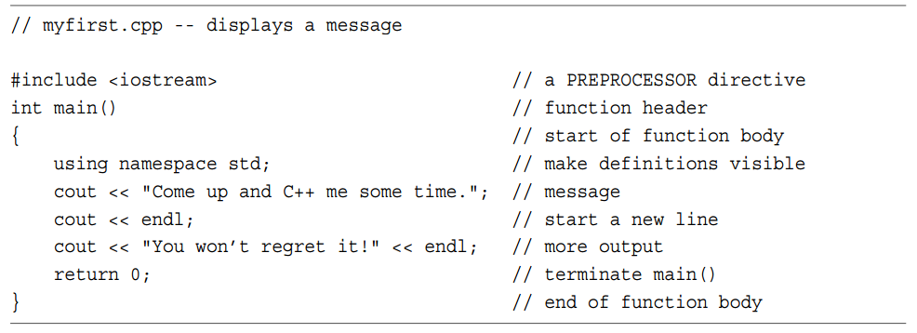
A simple program to show C++ basic grammar – a simple piece of code
1. Must include <iostream>
2. Namespace: we will introduce later
3. C++ use cout/cin to print messages.

Slide 6
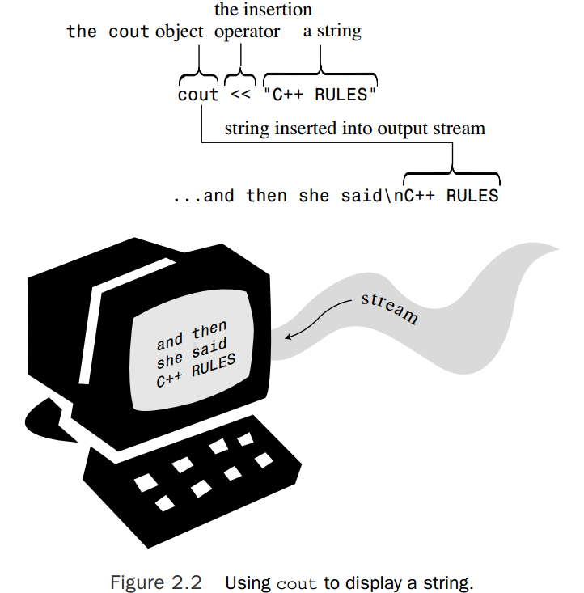
A simple program to show C++ basic grammar -- cout/cin
To use the usual C++ input or output facilities, you provide these two lines:
#include <iostream> using namespace std;
cout to print messages
cout is a predefined object that knows how to display a variety of things, including strings, numbers, and individual characters.
The << notation indicates that the statement is sending the string to cout
<< is an operator overloading. (we will introduce later)
The Manipulator endl is a special C++ notation, means: “\n”.
cout can just be used like printf does.
Concatenating with cout : cout << "Now you have " << carrots << " carrots." << endl;
cin to read messages
Like cout, cin is a smart object.
cin can be used like scanf do;

Slide 7
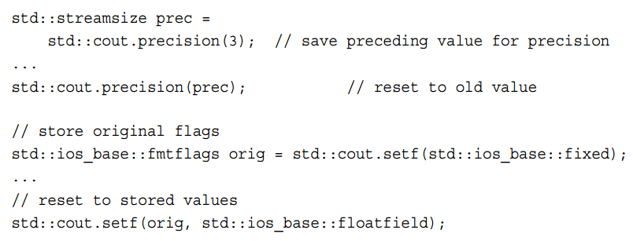
A simple program to show C++ basic grammar -- cout/cin
We can change the cout behavior to let it show special format.

Slide 8
Dealing with data -- special variable initialization way
int emus{7}; // set emus to 5 int rheas = {12}; // set rheas to 12 int rocs = {}; // set rocs to 0 int psychics{}; // set psychics to 0
the reason is to make using C++ easier for the novice
C++ added the parentheses form of initialization to make initializing ordinary variablesmore like initializing class variables

Slide 9
Dealing with data -- type casts
C++ empowers you to force type conversions explicitly via the type cast mechanism
(typeName) value // converts value to typeName type. The C style. typeName (value) // converts value to typeName type . The C++ style. It looks like a function call
C++ also introduces four type cast operators that are more restrictive in how they can be used
static_cast<typeName> (value) // converts value to typeName type
we introduce them later.

Slide 10
Compound types --Special C++11 Array Initialization
double earnings[4] {1.2e4, 1.6e4, 1.1e4, 1.7e4}; // okay with C++11
unsigned int counts[10] = {}; // all elements set to 0 float balances[100] {}; // all elements set to 0

Slide 11
Compound types --Strings classs
C++ supports the C-style string which we will not discuss here.
To use string class, you should:
#include <string> using namespace std;
The main difference between string objects and character arrays shown in Listing 4.7 is that you declare a string object as a simple variable, not as an array
The string class, with its automatic resizing as necessary, avoids overrunning adjacent memory.
Tips to use string class:
You can initialize a string object to a C-style string.
You can use cin to store keyboard input in a string object.
You can use cout to display a string object.
You can use array notation to access individual characters stored in a string object.

Slide 12
Compound types --Strings classs
Operations to a C++ string:
C++11 String Initialization
string third_date = {"The Bread Bowl"}; string fourth_date {"Hank's Fine Eats"}
Assignment, Concatenation, and Appending
you can’t simply assign one array to another. But you can assign one string object to another . Eg: str1 = str2;
Use: “+”,”+=“ . Eg: str3 = str1 + str2; // assign str3 the joined strings str1 += str2; // add str2 to the end of str1.
you can add and append C-style strings as well as string objects to a string object.
Difference of getline() function between C-style string and string object
cin.getline(charr, 20); // charr is an C style array and getline is a class method of cin
getline(cin,str); // str is a string object, and getline is not a class method.
Reason: cin is an istream object, and is part of C++ long before string class. So the istream design recognizes basic C++ types such as double and int, but it is ignorant of thestring type

Slide 13
Compound types --Strings classs
string class method and usage://TODO
Method | Description | Example
find() | 它返回匹配子串的第一个字符的索引位置 | string::size_type pos = name.find( "Anna" );
find_first_of() | 查找与被搜索字符串中任意一个字符相匹配的第一次出现 | pos = textline.find_first_of( ' ', pos )
substr() | 提取字符串 | textline.substr(prev_pos, pos-prev_pos)
rfind() | 查找最后 即最右 的指定子串的出现 | string::size_type last_pos = river.rfind( "is" );
find_first_not_of()
find_last_of()
find_last_not_of()
erase()
compare()
replace()
swap()

Slide 14
Compound types --Pointers(new and delete)
new and delete
“new” operator to allocate memory dynamically:
typeName * pointer_name = new typeName; // a general way, including structure
type_name * pointer_name = new type_name [num_elements]; // a general way
int * pn = new int; // to allocate a memory with size of int
int * psome = new int [10]; // get a block of 10 ints
“delete” to free the memory:
delete pn; // delete the pn memory
delete [] psome; // free a dynamic array
int * ps = new int; // allocate memory int * pq = ps; // set second pointer to same block delete pq; // delete with second pointer
Rules to keep in mind:
Don’t use delete to free memory that new didn’t allocate.
Don’t use delete to free the same block of memory twice in succession.
Use delete [] if you used new [] to allocate an array.
Use delete (no brackets) if you used new to allocate a single entity.
It’s safe to apply delete to the null pointer (nothing happens)

Slide 15
Compound types --Pointers(new and delete)
new with initialization
int *pi = new int (6); // *pi set to 6
struct where {double x; double y; double z;}; where * one = new where {2.5, 5.3, 7.2}; // C++11 int * ar = new int [4] {2,4,6,7}; // C++11
double * pdo = new double {99.99}; // *pd set to 99.99 // C++11

Slide 16
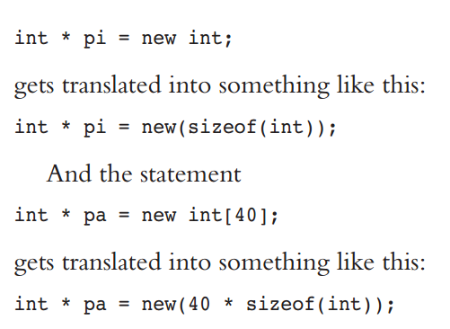
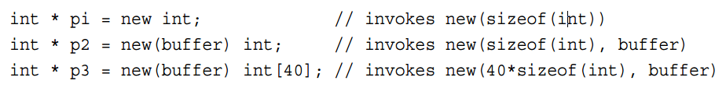
Compound types --Pointers(new and delete)
new/delete: Operators, Functions, and Replacement Functions (进阶知识)
The new/delete and new/delete[] operators call upon two allocation functions: void * operator new(std::size_t); // used by new void * operator new[](std::size_t); // used by new[] void operator delete(void *); // used by delete void operator delete[](void *); // used by delete[]
They use the operator-overloading syntax to realize this.
Interestingly, C++ terms these functions replaceable. That means if you have sufficient expertise and desire, you can supply replacement functions for new and delete and tailor them to meet your specific requirements.
The Placement new Operator .
The new operator has a variation, called placement new, that allows you to specify the location to be used
#include <new> // first, the regular forms of new p1 = new chaff; // place structure in heap p3 = new int[20]; // place int array in heap // now, the two forms of placement new p2 = new (buffer1) chaff; // place structure in buffer1 p4 = new (buffer2) int[20]; // place int array in buffer2
The placement new function is not replaceable, but it can be overloaded. It needs at least two parameters, the first of which always is a std::size_t parameter designating the number of bytes requested. Any such overloaded function is termed a placement new, even if the additional parameters don’t specify a location.

Slide 17
Compound types --Vector class
The vector template class is similar to the string class
To use vector class, you should:
#include <vector> using namespace std;
Delare a vector object:
vector<typeName> vt(n_elem); //a general way The parameter n_elem can be an integer constant or an integer variable.
vector<int> vi; // create a zero-size array of int vector<double> vd(n); // create an array of n doubles
The vector class has more capabilities than the built-in array type, but this comes at a cost of slightly less efficiency. If all you need is a fixed-size array, it could be advantageous to use the built-in type.

Slide 18
Compound types --Vector class
the vector class methods://TODO
Method | Description | Example

Slide 19
Compound types --array class
Like the built-in type, an array object has a fixed size and uses the stack (or else static memory allocation) instead of the free store, so it shares the efficiency of built-in arrays. To this it adds convenience and additional safety .
To use array class, you should:
#include <array> using namespace std;
Declare array class object:
array<typeName, n_elem> arr; // a general way. Unlike the case for vector, n_elem can’t be a variable.
array<int, 5> ai; // create array object of 5 ints array<double, 4> ad = {1.2, 2.1, 3.43. 4.3}

Slide 20
Loops --The Range-Based for Loop
The C++11 adds a new form of loop called the range-based for loop
It simplifies one common loop task—that of doing something with each element of an array, or, more generally, of one of the container classes, such as vector or array. Here is an example:
double prices[5] = {4.99, 10.99, 6.87, 7.99, 8.49}; for (double x : prices) cout << x << std::endl;

Slide 21
Functions -- Reference Variables
A reference is a name that acts as an alias, or an alternative name, for a previously defined variable .
create reference variables:
int rats; int & rodents = rats; // makes rodents an alias for rats
It is mandatory to initialize the reference when you declare it .
You can only set a reference by an initializing declaration, not by assignment. This means once reference variable is initialized, it can not be changed.

Slide 22
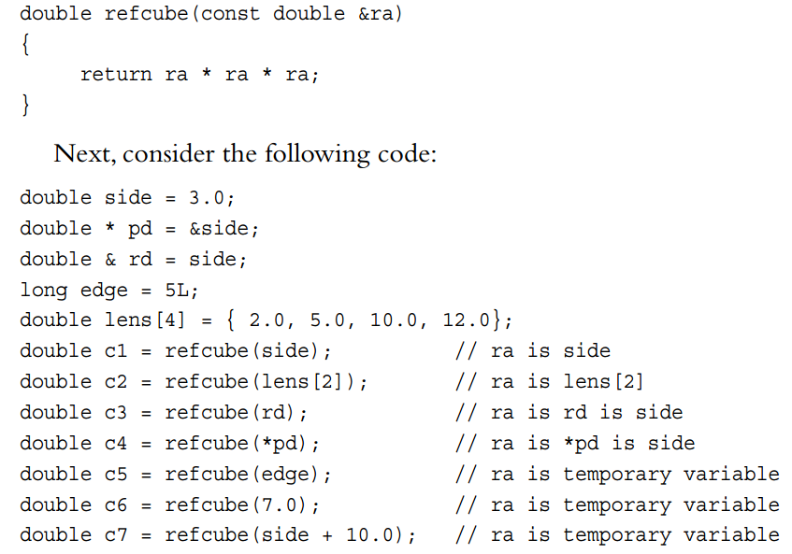
Functions -- Reference as function parameters
This method of passing arguments is called passing by reference .
Passing by reference allows a called function to access variables in the calling function. Just like a pointer as parameter.
Reference arguments become useful with larger data units, such as structures and classes .
lvalue is a data object that can be referenced by address
modifiable lvalue , non-modifiable lvalue(like const variable)
Provided that the reference parameter is a const, the compiler generates a temporary variable in two kinds of situations:
When the actual argument is the correct type but isn’t an lvalue
When the actual argument is of the wrong type, but it’s of a type that can be converted to the correct type
These temporary variables last for the duration of the function call
Note: Only const reference parameter allow this. Otherwise, compiler will report error. Do you know why???

Slide 23
Functions -- Reference as function parameters
There are three strong reasons to declare reference arguments as references to constant data:
Using const protects you against programming errors that inadvertently alter data.
Using const allows a function to process both const and non-const actual arguments, whereas a function that omits const in the prototype only can accept nonconst data.
Using a const reference allows the function to generate and use a temporary variable appropriately.

Slide 24
Functions -- Reference as return value
free_throws & accumulate(free_throws & target, const free_throws & source) accumulate(dup,five) = four;
assign a value to a function call is OK if the return value is a reference.
Why Return a Reference?
dup = accumulate(team,five); If accumulate() returned a structure instead of a reference to a structure, this could involve copying the entire structure to a temporary location and then copying that copy to dup. But with a reference return value, team is copied directly to dup, a more efficient approach.
why return a const reference?
when you don’t want the return value to be modified, then you should use const reference.

Slide 25
Functions -- Reference, Objects and Inheritance
A base class reference can refer to a derived class object without requiring a type cast. The practical upshot of this is that you can define a function having a base class reference parameter, and that function can be used with base class objects and also with derived objects.
Example:
void file_it(ostream & os, double fo, const double fe[],int n);
ofstream fout; file_it(fout, objective, eps, LIMIT); file_it(cout, objective, eps, LIMIT);

Slide 26
Functions --Default Arguments
A default argument is a value that’s used automatically if you omit the corresponding actual argument from a function call.
The method is to assign a value to the argument in the prototype
char * left(const char * str, int n = 1);
When you use a function with an argument list, you must add defaults from right to left
int harpo(int n, int m = 4, int j = 5); // VALID int chico(int n, int m = 6, int j); // INVALID int groucho(int k = 1, int m = 2, int n = 3); // VALID beeps = harpo(2); // same as harpo(2,4,5) beeps = harpo(1,8); // same as harpo(1,8,5) beeps = harpo (8,7,6); // no default arguments used beeps = harpo(3, ,8); // invalid, doesn't set m to 4
When you begin working with class design, you’ll find that they can reduce the number of constructors, methods, and method overloads you have to define

Slide 27
Functions --Function overloading(polymorphism)
Function polymorphism, also called function overloading, lets you use multiple functions sharing the same name
Both expressions boil down to the same thing, but we’ll usually use the expression function overloading
Function signature : a function’s argument list
If two functions use the same number and types of arguments in the same order, they have the same signature; the variable names don’t matter .
Examples:
void print(const char * str, int width); // #1 void print(double d, int width); // #2 void print(long l, int width); // #3 void print(int i, int width); // #4 void print(const char *str); // #5

Slide 28
Functions --Function overloading(polymorphism)
Some signatures that appear to be different from each other nonetheless can’t coexist
double cube(double x); double cube(double & x); cout << cube(x); // the compiler don’t know chose which function. they both match.
The function-matching process discriminate between const and non-const variables
void dribble(char * bits); // overloaded void dribble (const char *cbits); // overloaded with above. void dabble(char * bits); // not overloaded void drivel(const char * bits); // not overloaded Here’s what various function calls would match: const char p1[20] = "How's the weather?"; char p2[20] = "How's business?"; dribble(p1); // dribble(const char *); dribble(p2); // dribble(char *); dabble(p1); // no match dabble(p2); // dabble(char *); drivel(p1); // drivel(const char *); drivel(p2); // drivel(const char *);
It’s valid to assign a non-const value to a const variable, but not vice versa.
Keep in mind that the signature, not the function type, enables function overloading. For example, the following two declarations are incompatible:
long gronk(int n, float m); // same signatures, double gronk(int n, float m); // hence not allowed

Slide 29
Functions --Function overloading(polymorphism)
When to Use Function Overloading
overloading for functions that perform basically the same task but with different forms of data
To check whether you can accomplish the same end by using default arguments to avoid overuse overloading.

Slide 30
Functions --Function Templates
You should use templates if you need functions that apply the same algorithm to a variety of types
A function template is a generic function description; that is, it defines a function in terms of a generic type for which a specific type, such as int or double, can be substituted.
By passing a type as a parameter to a template, you cause the compiler to generate a function for that particular type
Because templates let you program in terms of a generic type instead of a specific type, the process is sometimes termed generic programming(泛型函数，泛型编程，泛型算法).
Because types are represented by parameters, the template feature is sometimes referred to as parameterized types(参数化） .
Function templates enable you to define a function in terms of some arbitrary type.
template <typename AnyType> void Swap(AnyType &a, AnyType &b) { AnyType temp; temp = a; a = b; b = temp; } note: the “typename” can be replaced with “class”. They are the same.

Slide 31
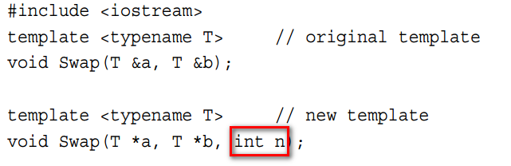
Functions --Function Templates
Note that function templates don’t make executable programs any shorter 。
you will wind up get separated functions generated by the compiler by substituting the types. just like you defined each function manually.
the final code doesn’t contain any templates; it just contains the actual functions generated for the program.
The benefits of templates are that they make generating multiple function definitions simpler and more reliable.
You can overload template definitions, just as you overload regular function definitions.
Note: Not all template arguments have to be template parameter types. like below: n is a specific type of int.

Slide 32
Functions --Function Templates
Function template limitations:
you should be care of “+”, or “<“… operator. they may not be supported. such as the type is a structure.
operator overloading can solve this problem.

Slide 33
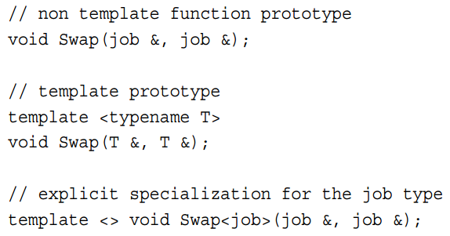
Functions --Explicit Specializations
Why we need explicit specialization(显示特化)
In some cases, we may want do some special things with certain special types while the general template function can not achieve this.
What is explicit specialization.
For a given function name, you can have a non template function, a template function, and an explicit specialization template function, along with overloaded versions of all of these.
The prototype and definition for an explicit specialization should be preceded by template <> and should mention the specialized type by name.
A specialization overrides the regular template, and a non template function overrides both.

Slide 34
Functions -- instantiation
When the compiler uses the template to generate a function definition for a particular type, the result is termed an instantiation of the template(模板实例化）
C++ allows for explicit instantiation. That means you can instruct the compiler to create a particular instantiation
template void Swap<int>(int, int); // explicit instantiation
cout << Add<double>(x, m) << endl; // explicit instantiation in a function
Swap<double>(m, x); // almost works
A compiler that implements this feature will, upon seeing this declaration, use the template to generate an instantiation, using the specific type.
It is an error to try to use both an explicit instantiation and an explicit specialization for the same type(s) in the same file, or, more generally, the same translation unit
Note: Implicit instantiations, explicit instantiations, and explicit specializations collectively are termed specializations(都叫特化）

Slide 35
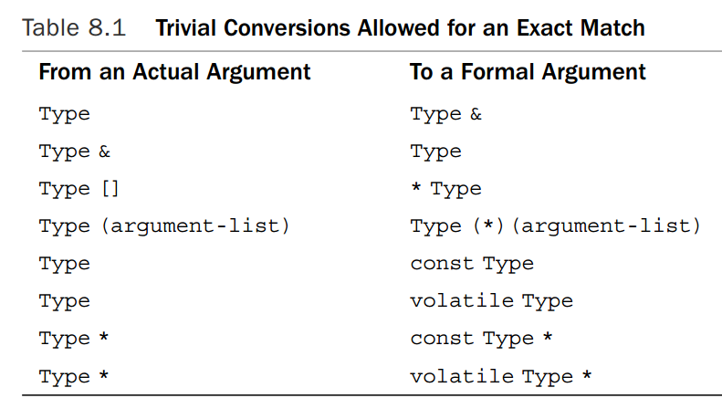
Functions -- Function matching
How the C++ choose a suitable function for a function call?
Phase 1—Assemble a list of candidate functions. These are functions and template functions that have the same names as the called functions.
Phase 2—From the candidate functions, assemble a list of viable functions. These are functions with the correct number of arguments and for which there is an implicit conversion sequence, which includes the case of an exact match for each type of actual argument to the type of the corresponding formal argument.
Phase 3—Determine whether there is a best viable function. If so, you use that function. Otherwise, the function call is an error.
Exact Matches and Best Matches

Slide 36
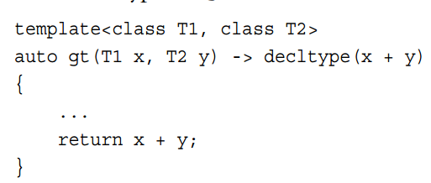
Functions --Template Function Evolution
Here are some advanced feature and we can just know it.
The decltype Keyword (C++11)
decltype(expression) var; // makes var to the same type of expression.
decltype(5+0.5) a = 5 + 0.5; //make a to a float type.
trailing return type.
auto h(int x, float y) -> double {/* function body */};
->double is called a trailing return type.
auto, in another new C++11 role, is a placeholde

Slide 37
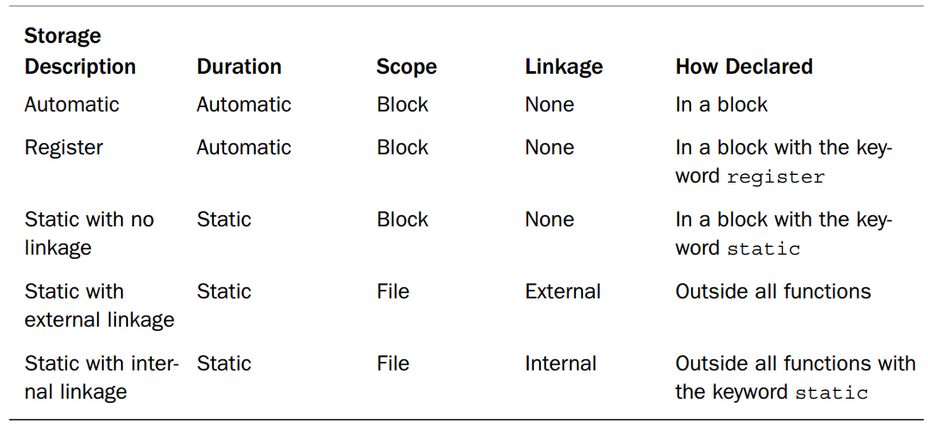
Memory Models and Namespaces --storage and duration
The Five Kinds of Variable Storage (the same as C)

Slide 38
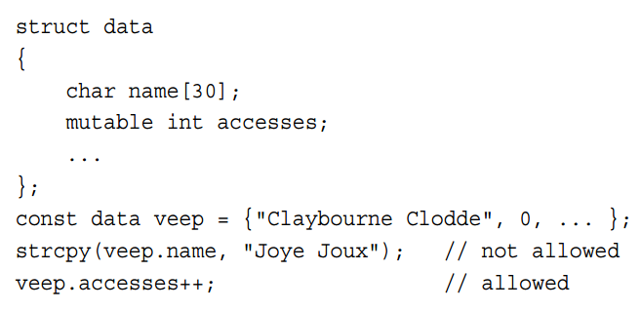
Memory Models and Namespaces --mutable
C++ has a qualifier called mutable:
use it to indicate that a particular member of a structure (or class) can be altered even if a particular structure (or class) variable is a const

Slide 39
Memory Models and Namespaces --const
Here is one thing that is different from C:
the const modifier alters the default storage classes slightly. Whereas a global variable has external linkage by default, a const global variable has internal linkage by default.
const int fingers = 10; // same as static const int fingers = 10;
so you can put const definition into the header file and several files can share it without build error.
you can use “external” key word to overwrite this behavior, Just like global variable.

Slide 40
Memory Models and Namespaces --language linkage
C++ compiler indulges in the process of name mangling or name decoration (as discussed in Chapter 8) to generate different symbolic names for overloaded functions. For example, it could convert spiff(int) to, say, _spiff_i, and spiff(double, double) to _spiff_d_d. The C++ approach is C++ language linkage.
C language linkage method is different from C++
if you want to use C functions in a C++ program:
extern "C" void spiff(int); // use C protocol for name look-up extern void spoff(int); // use C++ protocol for name look-up extern "C++" void spaff(int); // use C++ protocol for name look-up

Slide 41
Memory Models and Namespaces --namespace
Why we need name space:
When programming projects grow large, the potential for name conflicts increases. When you use class libraries from more than one source, you can get name conflicts. Such conflicts are termed namespace problems.
Some concepts:
A declarative region is a region in which declarations can be made (variables, functions…).
The potential scope for a variable begins at its point of declaration and extends to the end of its declarative region.
The portion of the program that can actually see the variable is termed the scope.

Slide 42
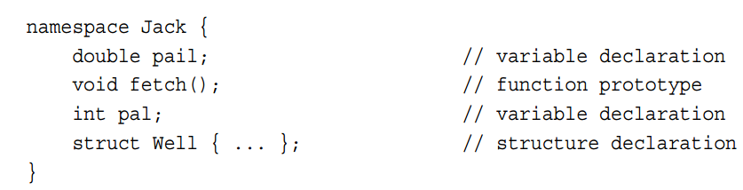
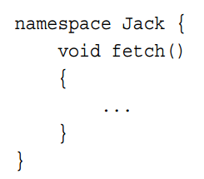
Memory Models and Namespaces --namespace
Use keyword namespace to create namespaces.
Namespaces are open, meaning that you can add names to existing namespaces
Eg: add new declaration to Jack:
Tips about namespace:
Namespaces can be located at the global level or inside other namespaces, but they cannot be placed in a block. Thus, a name declared in a namespace has external linkage by default (unless it refers to a constant).
The names in any one namespace don’t conflict with names in another namespace.
In addition to user-defined namespaces, there is one more namespace, the global namespace. This corresponds to the file-level declarative region, so what used to be termed global variables are now described as being part of the global namespace .

Slide 43
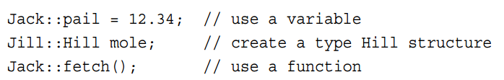
Memory Models and Namespaces --namespace
Access the namespace
by ::, the scope-resolution operator, to qualify a name with its namespace:
by using Declarations
using Jill::fetch; // a using declaration
A using declaration adds a particular name to the declarative region in which it occurs .
Placing a using declaration at the external level adds the name to the global namespace
by using Directives
A using declaration, then, makes a single name available. In contrast, the using directive makes all the names available
using namespace Jack; // make all the names in Jack available
Placing a using directive in a particular function makes the names available just in that function .

Slide 44
Memory Models and Namespaces --namespace
Comparison of using declaration and using directive
Generally speaking, the using declaration is safer to use than a using directive because it shows exactly what names you are making available.
And if the name conflicts with a local name, the compiler lets you know.
The using directive adds all names, even ones you might not need.
If a local name conflicts, it overrides the namespace version, and you aren’t warned.
Also the open nature of namespaces means that the complete list of names in a namespace might be spread over several locations, making it difficult to know exactly which names you are adding.

Slide 45
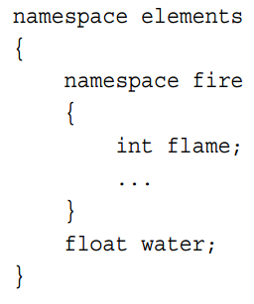
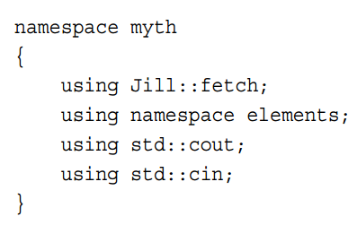
Memory Models and Namespaces --namespace
Nest namespace
elements::fire::flame
using namespace elements::fire;
use using directives and using declarations inside namespaces
create an alias for a namespace
namespace mvft = my_very_favorite_things

Slide 46
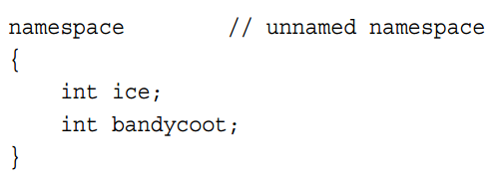
Memory Models and Namespaces --namespace
Unnamed namespace
the names declared in this namespace are in potential scope until the end of the declarative region that contains the unnamed namespace
you can’t explicitly use a using directive or using declaration to make the names available elsewhere
you can’t use names from an unnamed namespace in a file other than the one that contains the namespace declaration.
This provides an alternative to using static variables with internal linkage

Slide 47
Memory Models and Namespaces --namespace
Advices on using namespace
Use variables in a named namespace instead of using external global variables.
Use variables in an unnamed namespace instead of using static global variables.
If you develop a library of functions or classes, place them in a namespace. Indeed, C++ currently already calls for placing standard library functions in a namespace called std. This extends to functions brought in from C.
Use the using directive only as a temporary means of converting old code to namespace usage.
Don’t use using directives in header files; for one thing, doing so conceals which names are being made available. Also the ordering of header files may affect behavior. If you use a using directive, place it after all the preprocessor #include directives.
Preferentially import names by using the scope-resolution(::) operator or a using declaration.
Preferentially use local scope instead of global scope for using declarations

Slide 48
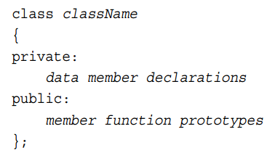
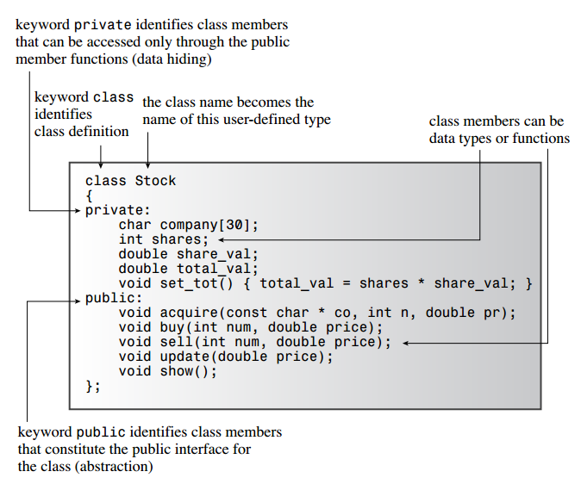
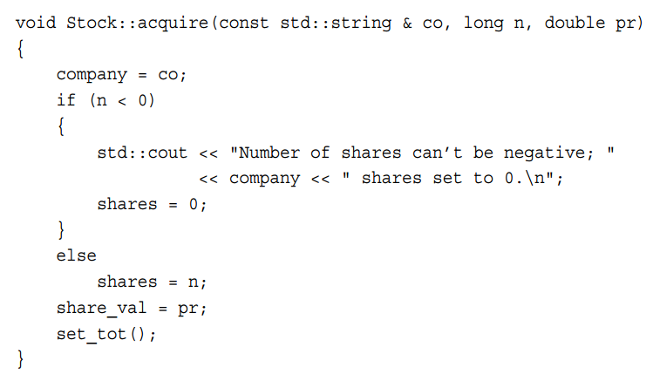
Objects and Classes --class definition
Gathering the implementation details together and separating them from the abstraction is called encapsulation(封装).
Data hiding (putting data into the private section of a class) is an instance of encapsulation .
You don’t have to use the keyword private in class declarations because that is the default access control for class objects
Implement the class member function:
When you define a member function, you use the scope-resolution operator (::) to identify the class to which the function belongs.
Class methods can access the private components of the class.

Slide 49
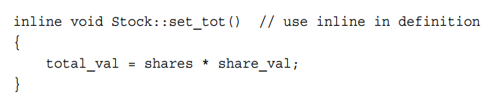
Objects and Classes --inline method
Any function with a definition in the class declaration automatically becomes an inline function.
You can define a member function outside the class declaration and still make it inline
The special rules for inline functions require that they be defined in each file in which they are used. The easiest way to make sure that inline definitions are available to all files in a multifile program is to include the inline definition in the same header file in which the corresponding class is defined
Defining a method within a class declaration is equivalent to replacing the method definition with a prototype and then rewriting the definition as an inline function immediately after the class declaration

Slide 50
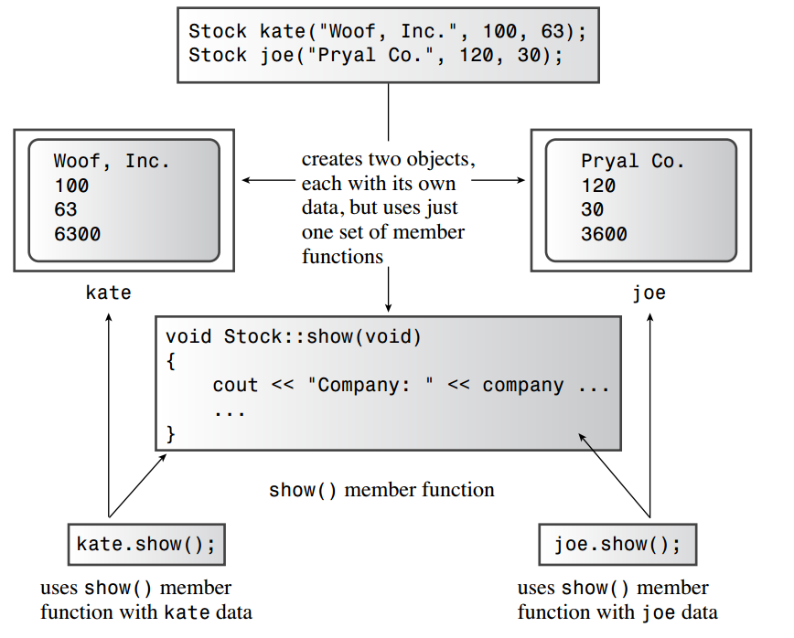
Objects and Classes --Using the class and objects

Slide 51
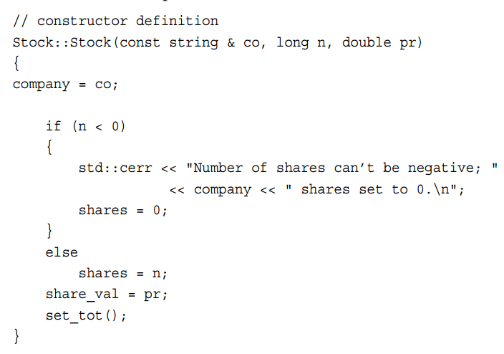
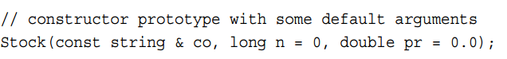
Objects and Classes --Class Constructors
C++ provides for special member functions, called class constructors. a program automatically invokes the constructor when it declares an object.
The name is the same as the class name.
Although the constructor has no return value, it’s not declared type void.
You can’t use an object to invoke a constructor
Declaring and Defining Constructors

Slide 52
Objects and Classes --Class Constructors
C++ provides two ways to initialize an object by using a constructor.
The first is to call the constructor explicitly : Stock food = Stock("World Cabbage", 250, 1.25);
The second way is to call the constructor implicitly: Stock garment("Furry Mason", 50, 2.5);
To use the constructor with new
Stock *pstock = new Stock("Electroshock Games", 18, 19.0);
C++11 way to initialize
Stock hot_tip = {"Derivatives Plus Plus", 100, 45.0};// match Stock::Stock(const std::string & co, long n = 0, double pr = 0.0); Stock jock {"Sport Age Storage, Inc"}; // match Stock::Stock(const std::string & co, long n = 0, double pr = 0.0); Stock temp {};

Slide 53
Objects and Classes --Class Constructors
Default constructor
A default constructor is a constructor that is used to create an object when you don’t provide explicit initialization values Stock fluffy_the_cat; // uses the default constructor
If you fail to provide any constructors, C++ automatically supplies a default constructor. It’s an implicit version of a default constructor, and it does nothing
After you define any constructor for a class, the responsibility for providing a default constructor for that class passes from the compiler to you. Otherwise: Stock stock1; // not possible with current constructor ,build error.
Two ways to define the default constructor:
One is to provide default values for all the arguments to the existing constructor Stock(const string & co = "Error", int n = 0, double pr = 0.0);
The second is to use function overloading to define a second constructor, one that has no arguments: Stock();
these two ways can NOT coexist.

Slide 54
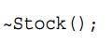
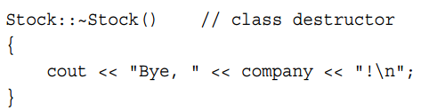
Objects and Classes --Class Destructors
When a object expires, the program automatically calls a special member function bearing the formidable title destructor.
a destructor has a special name: It is formed from the class name preceded by a tilde (~)
a destructor can have no return value and has no declared type
a destructor must have no arguments
If you don’t provide one, the compiler implicitly declares a default constructor
you cannot overloading a destructor as the destructor have no arguments.
Declaring and Defining Destructors

Slide 55
Objects and Classes --const member function
Place the const keyword after the function parentheses says a function promises not to modify the invoking object. Class functions declared and defined this way are called const member functions
void show() const; // declaration. promises not to change invoking object void stock::show() const // definition. promises not to change invoking object
Why we need this?
const Stock land = Stock("Kludgehorn Properties"); land.show();
Here, we have no way to guarantee the show would not modify the land object. because it has no parameter. so, const is needed.

Slide 56
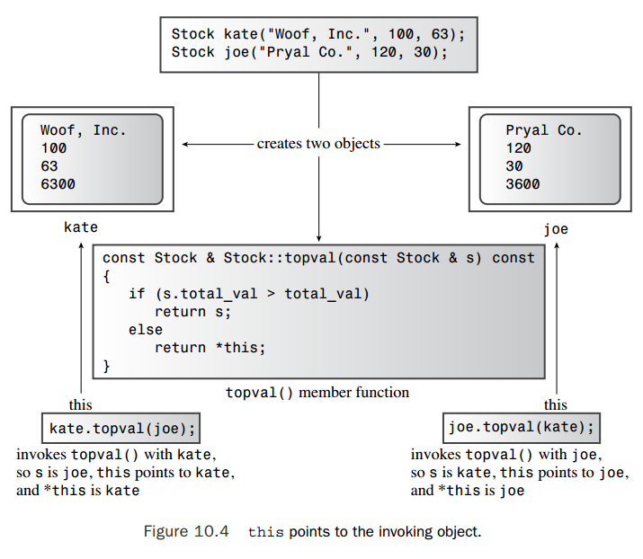
Objects and Classes --The this Pointer
The this pointer points to the object used to invoke a member function.
Basically, this is passed as a hidden argument to the method.
all class methods have a this pointer set to the address of the object that invokes the method

Slide 57
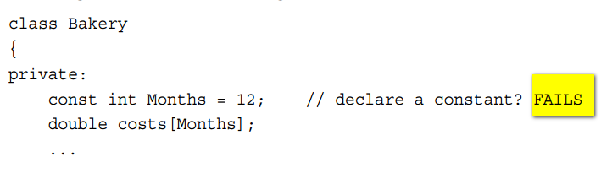
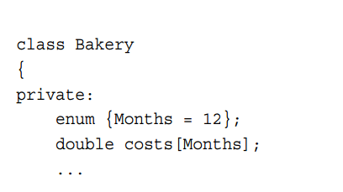
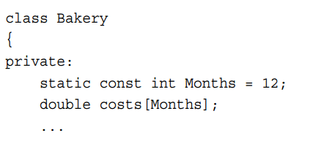
Objects and Classes --class scope
C++ classes introduce a new kind of scope: class scope
Class scope applies to names defined in a class.
Items that have class scope are known within the class but not outside the class
Also class scope means you can’t directly access members of a class from the outside world
To invoke a public member function, you have to use an object
Class Scope Constants
Fail: this won’t work because declaring a class describes what an object looks like but doesn’t create an object. Hence, until you create an object, there’s no place to store a value.
OK: you can declare an enumeration within a class. An enumeration given in a class declaration has class scope. This will not introduce variable member, the compiler will replace it with 12 while copiling.
OK: This creates a single constant called Months that is stored with other static variables rather than in an object.

Slide 58
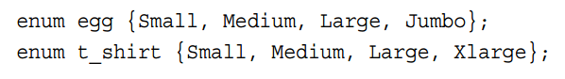
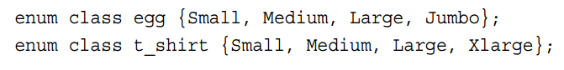
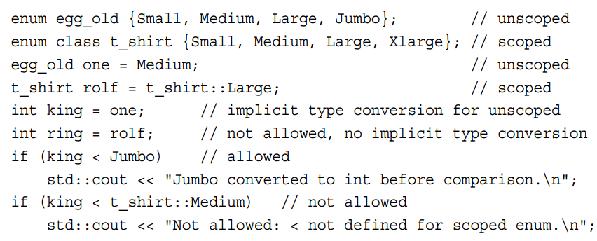
Objects and Classes --class scope
Scoped Enumerations (C++11)
solution
this will NOT work because egg and t_shirt are in the same namespace and have name confilict.
C++11 provides a new form of enumeration that avoids this problem by having class scope for its enumerators. the keyword “class” can also be “struct”
you now need to use the enum name to qualify the enumerator
C++11 also tightens up type security for scoped enumerations
Regular enumerations get converted to integer types automatically in some situations
scoped enumerations have no implicit conversions to integer types
But you can do an explicit type conversion if you feel you have to
By default, the underlying type for C++11 scoped enumerations is int.
Furthermore, there’s a syntax for indicating a different type.
// underlying type for pizza is short enum class : short pizza {Small, Medium, Large, XLarge};

Slide 59
Enhanced feature of Objects and classes --Operator overloading
Operator overloading is an example of C++ polymorphism(多态)
The compiler uses the number and type of operands to determine which definition of operator to use
To overload an operator, you use a special function form called an operator function:
operatorop(argument-list)
op is the symbol for the operator being overloaded
operator+() overloads the + operator operator*() overloads the * operator.
The op has to be a valid C++ operator; you can’t just make up a new symbol. For example, you can’t have an operator@() function because C++ has no @ operator
district2 = sid + sara; are the same as district2 = sid.operator+(sara);
left operand:
object to invoke the operator function
right operand:
object to be used as parameter of the operator function

Slide 60
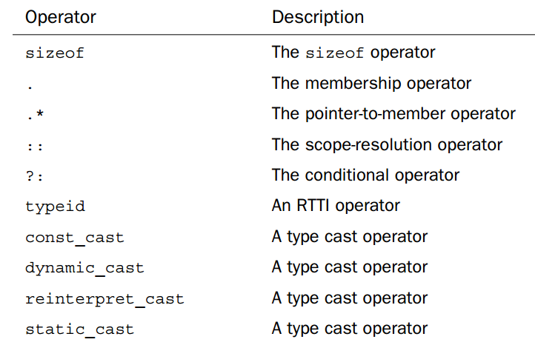
Enhanced feature of Objects and classes --Operator overloading
User-defined Operator Overloading Restrictions
The overloaded operator must have at least one operand that is a user-defined type. This prevents you from overloading operators for the standard types.
You can’t use an operator in a manner that violates the syntax rules for the original operator. Similarly, you can’t alter operator precedence.
You can’t create new operator symbols
You cannot overload the following operators :

Slide 61
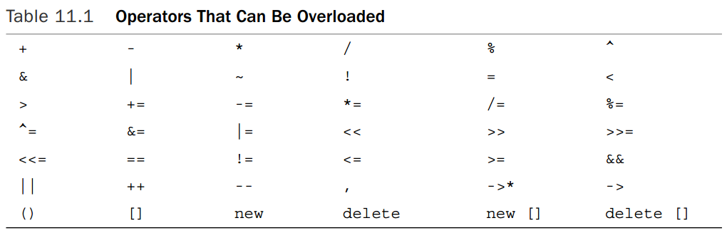
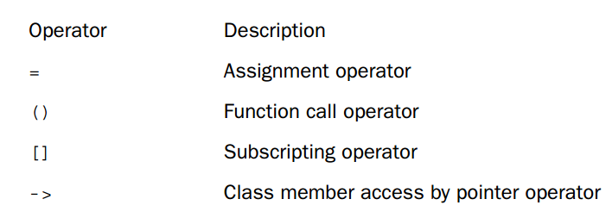
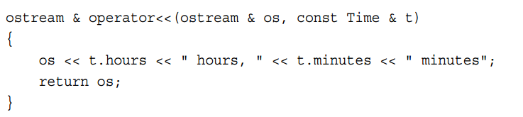
Enhanced feature of Objects and classes --Operator overloading
User-defined Operator Overloading Restrictions
Most of the operators in Table 11.1 can be overloaded by using either member or nonmember functions. However, you can use only member functions to overload the following operators
these operator can only use member function to overload

Slide 62
Enhanced feature of Objects and classes --Friends
C++ controls access to the private portions of a class object. But sometimes this restriction is too rigid to fit particular programming problems. In such cases, C++ provides another form of access: the friend. Friends come in three varieties:
Friend functions
Friend classes (we will discuss later)
Friend member functions (we will discuss later)

Slide 63
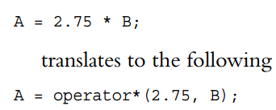
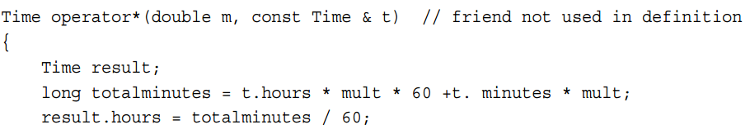
Enhanced feature of Objects and classes --Friends ----Friends functions
Why we need friends functions?
A = 2.75 * B; // this will fail because 2.75 is not a object.(left operand to invoke)
So, we need a nomember function: Time operator*(double m, const Time & t);
But nomember function have no access to private members. So we need friends.
Creating Friends
step1: place a prototype in the class declaration and prefix the declaration with the keyword friend:
Although the operator*() function is declared in the class declaration, it is not a member function. So it isn’t invoked by using the membership operator.
Although the operator*() function is not a member function, it has the same access rights as a member function.
step2: write the function definition. Because it is not a member function, you don’t use the Time:: qualifier. Also you don’t use the friend keyword in the definition. The definition should look like this:

Slide 64
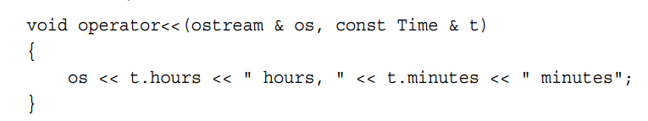
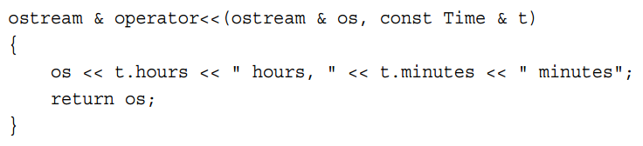
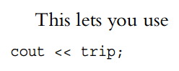
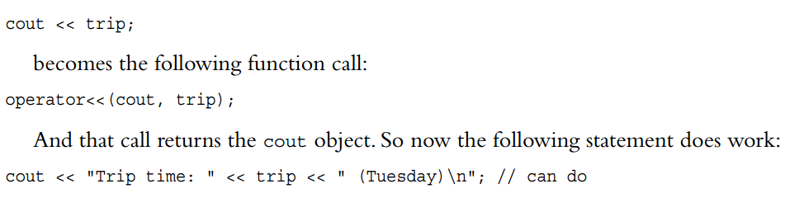
Enhanced feature of Objects and classes --Friends ----Friends functions
Overloading the << Operator
How to realize: cout << trip; //trip is a user-defined class
Way1: make the cout recognize trip.
This need modify the ostream interface,
add a new operator function for <<. This is
NOT a good way for it modify the stantdard
file.
Way2: add a friend operator function.
way3:another type of operator function
So, it’s OK:
But:

Slide 65
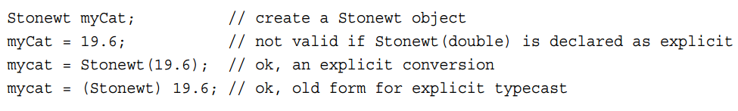
Enhanced feature of Objects and classes --Automatic Conversions and Type Casts for Classes
In C++, any constructor that takes a single argument acts as a blueprint for converting a value of that argument type to the class type.
Stonewt myCat; // create a Stonewt object myCat = 19.6; // use Stonewt(double) to convert 19.6 to Stonewt
This process is termed an implicit conversion because it happens automatically, without the need of an explicit type cast.
Only a constructor that can be used with just one argument works as a conversion function. The following constructor has two arguments, so it cannot be used to convert types: Stonewt(int stn, double lbs); // not a conversion function
C++ added a new keyword, explicit, to turn off the automatic aspect of the constructor. But you can do explicit conversions.

Slide 66
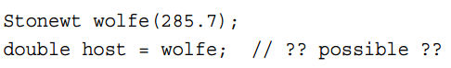
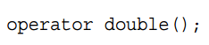
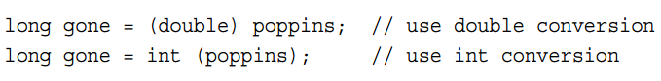
Enhanced feature of Objects and classes --Automatic Conversions and Type Casts for Classes
Conversion Functions
can you do this?
To do the reverse, you have to use a special form of a C++ operator function called a conversion function.
Conversion functions are user-defined type casts, and you can use them the way you would use a type cast.
To convert to type typeName, you use a conversion function in this form: operator typeName();
The conversion function must be a class method.
The conversion function must not specify a return type.
The conversion function must have no arguments.
The convertion function can return a desired value, even though there is no declared return type
When the class defines two or more conversions, you can still use an explicit type cast to indicate which conversion function to use

Slide 67
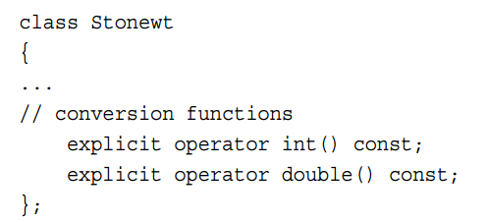
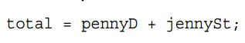
Enhanced feature of Objects and classes --Automatic Conversions and Type Casts for Classes
Conversion Functions
You can use keyword explicit to turn off the implicit calling of the conversion functions.
Conversion takes place for member function arguments, not for member function invokers
pennyD is a double type.
jennyST is a class type.
total is a class type.
This is NOT work because even if you have defined
a member operator function for “+”.
a conversion function for double().
Because the conversion will NOT take place in member function invokes.
That is the pennyD will not be converted to a class type.
The solution could be using a friend operator function.

Slide 68



Enhanced feature of Objects and classes --static member/member function of class
You can define a static member in a class using the keyword static.
All the objects share the same static variable.
The static variable is stored separately from the objects.
static const member.
we discuss before, and it can be like this: (Only int,enum can init in class declaration. other type must be init out side the cloass declaration like static member.)
the static member.
the initialize must be done out side the class declaration. It can be done in the .cpp file.

Slide 69
Enhanced feature of Objects and classes --static member/member function of class
It’s possible to declare a member function as being static. (The keyword static should appear in the function declaration but not in the function definition if the latter is separate.) This has two important consequences.
First, a static member function doesn’t have to be invoked by an object. it doesn’t even get a this pointer to play with. If the static member function is declared in the public section, it can be invoked using the class name and the scope-resolution operator.
The second consequence is that because a static member function is not associated with a particular object, the only data members it can use are the static data members.

Slide 70
Enhanced feature of Objects and classes --new/delete vs classes and objects
Tips for using new/delete
If you use new to initialize a pointer member in a constructor, you should use delete in the destructor.
The uses of new and delete should be compatible. You should pair new with delete and new [] with delete []
If there are multiple constructors, all should use new the same way. —either all with brackets or all without brackets. There’s only one destructor, so all constructors have to be compatible with that destructor.
You should define a copy constructor that initializes one object to another by doing deep copying.
You should define an assignment operator that copies one object to another by doing deep copying

Slide 71





Enhanced feature of Objects and classes --placement new
When creating a second object, placement new simply overwrites the same location used for the first object with a new object. Not only is this rude, it means that the destructor was never called for the first object
Second, using delete with pc2 and pc4 automatically invokes the destructors for the two objects that pc2 and pc4 point to. But using delete [] with buffer does not invoke the destructors for the objects created with placement new
delete works in conjunction with new but not with placement new
The pointer pc3, for example, does not receive an address returned by new, so delete pc3 throws a runtime error.The pointer pc1, on the other hand, has the same numeric value as buffer, but buffer is initialized using new [], so it’s freed using delete [], not delete.
For replacement new, you should invoke the destructor explicitly.
The objects constructed by placement new should be destroyed in order opposite that in which they were constructed. The reason is that, in principle, a later object might have dependencies on an earlier object. And the buffer used to hold the objects should be freed only after all the contained objects are destroyed.

Slide 72
Enhanced feature of Objects and classes --Special default Member Functions
C++ automatically provides the following member functions:
A default constructor if you define no constructors
A default destructor if you don’t define one
A copy constructor if you don’t define one
An assignment operator if you don’t define one
An address operator if you don’t define one

Slide 73

Enhanced feature of Objects and classes --Special default Member Functions ----copy constructor
A copy constructor is used to copy an object to a newly created object. not during ordinary assignment.
A copy constructor for a class normally has this prototype: Class_name(const Class_name &);
When a Copy Constructor Is Used
A copy constructor is invoked whenever a new object is created and initialized to an existing object of the same kind
Less obviously, a compiler uses a copy constructor whenever a program generates copies of an object. In particular, it’s used when a function passes an object by value or when a function returns an object.
A compiler also uses a copy constructor whenever it generates temporary objects.

Slide 74

Enhanced feature of Objects and classes --Special default Member Functions ----copy constructor
What a Default Copy Constructor Does
The default copy constructor performs a member-by-member copy of the nonstatic members (memberwise copying, also sometimes called shallow copying). Each member is copied by value .
Provide a explicit copy constructor
What makes defining the copy constructor necessary is the fact that some class members are new-initialized pointers to data rather than the data themselves.
If a class contains members that are pointers initialized by new, you should define a copy constructor that copies the pointed-to data instead of copying the pointers themselves. This is termed deep copying.

Slide 75

Enhanced feature of Objects and classes --Special default Member Functions ----assignment operator
C++ allows class object assignment. It does so by automatically overloading an assignment operator for a class. This operator has the following prototype:
Class_name & Class_name::operator=(const Class_name &);
When an Assignment Operator Is Used and What It Does
An overloaded assignment operator is used when you assign one object to another existing object.
An assignment operator is not necessarily used when initializing an object:
Like a copy constructor, an implicit implementation of an assignment operator performs a member-to-member copy.
it is implemention defined

Slide 76

Enhanced feature of Objects and classes --Special default Member Functions ----assignment operator
you can provide your own assignment operator to do a deep copy by the mechanism of operator overloading.

Slide 77
Class Inheritance
class inheritance, lets you derive new classes from old ones, with the derived(派生) class inheriting the properties, including the methods, of the old class, called a base class.
Here are some things you can do with inheritance:
You can add functionality to an existing class.
You can add to the data that a class represents.
You can modify how a class method behaves.

Slide 78

Class Inheritance -- deriving a class
To derive a class, it may be like:
The colon indicates that the RatedPlayer class is based on the TableTennisPlayer class
This particular heading indicates that TableTennisPlayer is a public base class. this is termed public derivation
With public derivation, the public members of the base class become public members of the derived class. The private portions of a base class become part of the derived class, but they can be accessed only through public and protected methods of the base class.

Slide 79


Class Inheritance -- Constructors: Access Considerations
A derived class does not have direct access to the private members of the base class; it has to work through the base-class methods
the derived-class constructors have to use the base-class constructors.
C++ uses the member initializer list(成员初始化列表) syntax to construct the base class object.
the member initializer list is executable code, and it calls the TableTennisPlayer constructor
if you omit calling a base-class constructor, the program uses the default base-class constructor
the constructor declaration of a derived class don’t need the declaration of member initializer list.

Slide 80


Class Inheritance -- Constructors: Access Considerations
You may, if you like, also use member initializer list syntax for members of the derived class. In this case, you use the member name instead of the class name in the list
Key points about constructors for derived classes:
The base-class object is constructed first.
The derived-class constructor should pass base-class information to a base-class constructor via a member initializer list.
The derived-class constructor should initialize the data members that were added to the derived class.
the order to destruct the object by destructor is opposite of the constructor : first derived object, then base object.

Slide 81



Class Inheritance -- Special Relationships Between Derived and Base Classes
The relationships are:
A derived-class object can use base-class methods, provided that the methods are not private
A base-class pointer can point to a derived class object without an explicit type cast. NOT for the opposite direction.
A base-class reference can refer to a derived-class object without an explicit type cast。 NOT for the opposite direction.
However, a base-class pointer or reference can invoke just base-class methods.
The fact that base-class references and pointers can refer to derived-class objects has some interesting consequences
One is that functions defined with base-class reference or pointer arguments can be used with either base-class or derived-class objects
The reference compatibility property also allows you to initialize a base-class object to a derived-class object, although somewhat indirectly. the program uses the implicit overloaded copy constructor.
Similarly, you can assign a derived-class object to a base-class object. In this case, the program uses the implicit overloaded assignment operator.

Slide 82
Class Inheritance -- Inheritance: An Is-a Relationship
C++ has three varieties of inheritance: public, protected, and private
Public inheritance is the most common form, and it models an is-a relationship (sometimes termed is-a-kind-of).
This is shorthand for saying that an object of a derived class should also be an object of the base class
has-a relationship : If one class A has a member of class B. A and B is a has-a relationship. That is A has a B.

Slide 83



Class Inheritance -- Polymorphic Public Inheritance
You can have multiple behaviors for a method, depending on the context and this is called polymorphic.
There are two key mechanisms for implementing polymorphic public inheritance:
Redefining base-class methods in a derived class
Using virtual methods
What if we use a virtual keyword in front of the function prototype?
It determines which method is used if the method is invoked by a reference or a pointer instead of by an object
If you don’t use the keyword virtual, the program chooses a method based on the reference type or pointer type
If you do use the keyword virtual, the program chooses a method based on the type of object the reference or pointer refers to.
Therefore, it is the common practice to declare as virtual in the base class those methods that might be redefined in a derived class
When a method is declared virtual in a base class, it is automatically virtual in the derived class, but it is a good idea to document which functions are virtual by using the keyword virtual in the derived class declarations, too
We can define the same function in both base class and derived class (with or without keyword virtual). This means that they have different operations. A program will use the object type to determine which version to use, like:

Slide 84
Class Inheritance -- Polymorphic Public Inheritance
The Need for Virtual Destructors
If the destructors are not virtual, then just the destructor corresponding to the pointer type is called.
If the destructors are virtual, the destructor corresponding to the object type is called
So if a pointer points to a BrassPlus object, the BrassPlus destructor is called.And when a BrassPlus destructor finishes, it automatically calls the base-class constructor
Thus, using virtual destructors ensures that the correct sequence of destructors is called
Tips for virtual:
Constructors can’t be virtual. Thus, a derived class doesn’t inherit the base-class constructors, so usually there’s not much point to making them virtual, anyway
Destructors should be virtual unless a class isn’t to be used as a base class.
Friends can’t be virtual functions because friends are not class members, and only members can be virtual functions.
If a derived class fails to redefine a function (virtual or not), the class will use the base class version of the function. If a derived class is part of a long chain of derivations, it will use the most recently defined version of the function.The exception is if the base versions are hidden, as described next

Slide 85


Class Inheritance -- Polymorphic Public Inheritance
Tips for virtual:
Redefinition Hides Methods: redefining inherited methods is not a variation of overloading. If you redefine a function in a derived class, it doesn’t just override the base class declaration with the same function signature. Instead, it hides all baseclass methods of the same name, regardless of the argument signatures. The derived class can not call them any more. (这句话意思是说，如过在子类里面重新实现一个父类的函数，而这个函数只是名字与父类相同，参数不同，那么这个行为会导致把父类的相同名字的函数“hide”起来。即子类无法再使用。而如果参数相同，则子类仍然可以看到父类的这个函数)
First, if you redefine an inherited method, you need to make sure you match the original prototype exactly (the return type can be different because of “covariance of return type”).
Second, if the base class declaration is overloaded, you need to redefine all the baseclass versions in the derived class
If a function in base class is declared as virtual, this function must be implemented.(如果父类的函数声明为虚函数，则这个函数必须有实现，否则编译不过。如果没有声明为虚函数，则只需要子类实现这个函数即可，父类可以不用实现这个函数。)

Slide 86

Class Inheritance -- Static and Dynamic Binding
Interpreting a function call in the source code as executing a particular block of function code is termed binding the function name
binding that takes place during compilation is called static binding (or early binding)
However, virtual functions make the job more difficult yet. the compiler has to generate code that allows the correct virtual method to be selected as the program runs; this is called dynamic binding (or late binding).
Dynamic binding in C++ is associated with methods invoked by pointers and references.
why two kinds of binding?
efficiency: stataci binding are more efficiency than dynamic binding.
conceptual model : we need dynamic /static to tell when our methods can be redefinition.
As discussed before, if ViewAcct() is not declared as virtual in the base class, bp->ViewAcct() goes by the pointer type (Brass *) and invokes Brass::ViewAcct().The pointer type is known at compile time. the compiler uses static binding for nonvirtual methods.
But if ViewAcct() is declared as virtual in the base class, bp->ViewAcct() goes by the object type (BrassPlus) and invokes rassPlus::ViewAcct().
The compiler uses dynamic binding for virtual methods

Slide 87


Class Inheritance -- Access Control: protected
The protected keyword is like private in that the outside world can access class members in a protected section only by using public class members
The difference between private and protected comes into play only within classes derived from the base class
Members of a derived class can access protected members of a base class directly, but they cannot directly access private members of the base class
However, protected access control can be quite useful for member functions, giving derived classes access to internal functions that are not available publicly

Slide 88

Class Inheritance --Abstract Base Classes(ABC) vs pure virtual functions
C++ has a way to provide an unimplemented function by using a pure virtual function. A pure virtual function has = 0 at the end of its declaration, as shown for the Area() method:
When a class declaration contains a pure virtual function, you can’t create an object of that class. The idea is that classes with pure virtual functions exist solely to serve as base classe
Pure virtual functions are used when it doesn't make sense to provide definition of a virtual function in the base class or a proper definition does not exists in the context of base class.
For a class to be a genuine ABC, it has to have at least one pure virtual function. It is the = 0 in the prototype that makes a virtual function a pure virtual function.
In short, the = 0 in the prototype indicates that the class is an abstract base class and that the class doesn’t necessarily have to define the function

Slide 89
Class Inheritance -- Inheritance and Dynamic Memory Allocation
Case 1: Derived Class Doesn’t Use new
You don’t have to define an explicit destructor, copy constructor, and assignment operator for the derived class.
Case 2: Derived Class Does Use new
You do have to define an explicit destructor, copy constructor, and assignment operator for the derived class.

Slide 90

Reusing code in C++ -- has-a relationships
The usual C++ technique for modeling has-a relationships is to use composition or containment—that is, to create a class composed of, or containing, members that are objects of another class
C++ has a second means of implementing the has-a relationship: private inheritance

Slide 91
Reusing code in C++ -- Private Inheritance
C++ has a second means of implementing the has-a relationship: private inheritance
With private inheritance, public and protected members of the base class become private members of the derived class. This means the methods of the base class do not become part of the public interface of the derived object. They can be used, however, inside the member functions of the derived class. That is:
The public portion of the base class will become private in derived class.
The protected portion of the base class will become private in derived class.
The private portion of the base class are still NOT accessible to derived class.
Containment adds an object to a class as a named member object, whereas private inheritance adds an object to a class as an unnamed inherited object
Private inheritance, then, provides the same features as containment: Acquire the implementation, don’t acquire the interface. Therefore it, too, can be used to implement a has-a relationship.
With private inheritance, a reference or pointer to a base class cannot be assigned a reference or pointer to a derived class without an explicit type cast.

Slide 92


Reusing code in C++ -- Private Inheritance
Initializing Base-Class Components
you can no longer use name to describe the object, because private inheritance has unnamed inherited object. so you can do this by class name.
Accessing Base-Class Methods
Private inheritance lets you use the class name and the scope-resolution operator to invoke base-class methods:
Accessing Base-Class Objects
The answer is to use a type cast. Because Student is derived from string, it’s possible to type cast a Student object to a string object; the result is the inherited string object.

Slide 93

Reusing code in C++ -- Private Inheritance
Accessing Base-Class Friends
A friend function is not a member of class, so you can use function name to invoke them directly.

Slide 94
Reusing code in C++ -- Containment or Private Inheritance?
Given that you can model a has-a relationship either with containment or with private inheritance, which should you use?
Most C++ programmers prefer containment.
First, it’s easier to follow for it has explicit name of objects.
Second, inheritance can raise problems, particularly if a class inherits from more than one base class.
Also containment allows you to include more than one subobject of the same class. If a class needs three string objects, you can declare three separate string members by using the containment approach. But inheritance limits you to a single object.
However, private inheritance does offer features beyond those provided by containment
Inheritance can access the base class protected members while containment cannot.
Another situation that calls for using private inheritance is if you want to redefine virtual functions.

Slide 95

Reusing code in C++ -- Protected Inheritance
Protected inheritance is a variation on private inheritance. It uses the keyword protected when listing a base class
C++ allow you to inheritance a base class with protected inheritance .
The public portion of the base class will become protected in derived class.
The protected portion of the base class will become protected in derived class.
The private portion of the base class are still NOT accessible to derived class.
The main difference between private and protected inheritance occurs when you derive another class from the derived class.
With private inheritance, this third-generation class doesn’t get the internal use of the base-class interface. That’s because the public base-class methods become private in the derived class, and private members and methods can’t be directly accessed by the next level of derivation.
With protected inheritance, public base-class methods become protected in the second generation and so are available internally to the next level of derivation.

Slide 96

Reusing code in C++ -- Summary of three kind of Inheritance
The term implicit upcasting means that you can have a base-class pointer or reference refer to a derived class object without using an explicit type cast.

Slide 97


Reusing code in C++ -- Redefining Access with using
You can use a using declaration (such as those used with namespaces) to announce that a particular base-class member can be used by the derived class, even though the derivation is private.
Note that the using declaration just uses the member name—no parentheses, no function signatures, no return types.
The using declaration approach works only for inheritance and not for containment
There is an older way to redeclare base-class methods in a privately derived class: You place the method name in the public section of the derived class. Here’s how you would do that:
This looks like a using declaration without the using keyword.This approach is deprecated, meaning that the intention is to phase it out.

Slide 98

Reusing code in C++ -- Multiple Inheritance
MI describes a class that has more than one immediate base class
As with single inheritance, public MI should express an is-a relationship
And private and protected MI can express a has-a relationship;
MI can introduce new problems for programmers. Thus, using MI can be more difficult and problem-prone than using single inheritance. For this reason, many in the C++ community object strongly to MI; some want it removed from the language. Others love MI and argue that it’s very useful, even necessary, for particular projects. Still others suggest using MI cautiously and in moderation(众说纷纭, 褒贬不一)

Slide 99




Reusing code in C++ -- Multiple Inheritance
Problems and solutions
1) Assign the address of a derived-class object to a base-class pointer, but this becomes ambiguous now. You could specify which object by using a type cast
2) Having two copies of a Worker object causes other problems, too. However, the real issue is why should you have two copies of a Worker object at all. So we have virtual base class to solve this problem.
Now a SingingWaiter object will contain a single copy of a Worker object

Slide 100


Reusing code in C++ -- Multiple Inheritance
For virtual base class, there are new problems：
1) New Constructor Rules
To avoid this potential conflict, C++ disables the automatic passing of information through an intermediate class to a base class if the base class is virtual. If you want to use something other than the default constructor for a virtual base class, you need to invoke the appropriate base constructor explicitly
2) To call a base class function

Slide 101


Reusing code in C++ -- Multiple Inheritance
For virtual base class, there are new problems：
3) Mixed Virtual and Nonvirtual Bases
M will have totally 3 B.
1 for C and D.
1 for X
1 for Y
4) Virtual Base Classes and Dominance
A name in a derived class dominates the same name in any ancestor class, whether direct or indirect(no matter if it is in private or not).
the q in class C dominate the q in class B. So we can use q() to denote C::q()
class C : virtual B{}
class D : virtual B{}
class X : B {}
class Y : B {}
class M
{
public:
C c;
D d;
X x;
Y y;
}

Slide 102



Reusing code in C++ -- Class templates
Inheritance (public, private, or protected) and containment aren’t always the solution when you want to reuse code
C++’s class templates provide a better way to generate generic class declarations. Templates provide parameterized types—that is, they are capable of passing a type name as an argument to a recipe for building a class or a function
Defining a Class Template.
the call can be replaced by typename.

Slide 103
Reusing code in C++ -- Class templates
Using a Template Class
Merely including a template in a program doesn’t generate a template class. You have to ask for an instantiation. To do this, you declare an object of the template class type, replacing the generic type name with the particular type you want
Notice that you have to provide the desired type explicitly. This is different from ordinary function templates, for which the compiler can use the argument types to a function to figure out what kind of function to generate

Slide 104

Reusing code in C++ -- Class templates
What if the type/class is a pointer in the template?
you must be care of the memory allocation.
Define a template with non-type
n is called non-type, or expression, argument.
Expression arguments have some restrictions. An expression argument can be an integer type, an enumeration type, a reference, or a pointer. So double type are not allowed.
Also when you instantiate a template, the value used for the expression argument should be a constant expression
The main drawback to the expression argument approach is that each array size generates its own template. That is, the following declarations generate two separate class declarations: ArrayTP<double, 12> eggweights; ArrayTP<double, 13> donuts;

Slide 105




Reusing code in C++ -- Class templates
Template Versatility
Using a Template Recursively
Using More Than One Type Parameter
Default Type Template Parameters

Slide 106

Reusing code in C++ -- Class templates
Template Versatility
You can apply the same techniques to template classes as you do to regular classes
Template classes can serve as base classes, and they can be component classes. They can themselves be type arguments to other templates.

Slide 107

Reusing code in C++ -- Class templates
Template Specializations
Class templates are like function templates in that you can have implicit instantiations, explicit instantiations, and explicit specializations, collectively known as specializations.
Implicit Instantiations
Explicit Instantiations
Explicit Specializations
The compiler generates an explicit instantiation of a class declaration when you declare a class by using the keyword template and indicating the desired type or type
you can provide an explicit template specialization. This takes the form of a template defined for one specific type instead of for a general type. When faced with the choice of a specialized template and a general template that both match an instantiation request, the compiler uses the specialized version
The second statement causes the compiler to generate a class definition and also an object that is created according to that definition

Slide 108


Reusing code in C++ -- Class templates
Template Specializations
Partial Specializations
The <> following the keyword template declares the type parameters that are still unspecialized. So the second declaration specializes T2 to int but leaves T1 open. Note that specifying all the types leads to an empty bracket pair and a complete explicit specialization. The compiler uses the most specialized template if there is a choice

Slide 109







Reusing code in C++ -- Class templates
Member template
A template can be a member of a structure, class, or template class.
Templates As Parameters
A template can also have a parameter that is itself a template. Such parameters are yet another template feature addition that is used to implement the STL.
Template Classes and Friends
Template class declarations can have friends, too. You can classify friends of templates into three categories:
Non-template friends
Bound template friends, meaning the type of the friend is determined by the type of the class when a class is instantiated
Unbound template friends, meaning that all specializations of the friend are friends to each specialization of the class

Slide 110


Reusing code in C++ -- Class templates
Template Aliases (C++11)
It can be convenient, especially in template design, to create aliases for types. You can use typedef to create aliases for template specializations:

Slide 111

Friend classes
A class also can be a friend
any method of the friend class can access private and protected members of the original class
Also you can be more restrictive and designate just particular member functions of a class to be friends to another class
When might you want to make one class a friend to another
When you want to use one class to change another class’s state.
Declare a friend class.
A friend declaration can appear in a public, private, or protected section; the location makes no difference.

Slide 112



Friend classes -- Friend Member Functions
Friend Member Functions
You do have the option of making just selected class members friends to another class rather than making the entire class a friend, but that’s a bit more awkward(尴尬)
The way to declare:
Note: the Remote should appear above the Tv. we can use forward declaration.
OK
NOT OK: The reason is that when the compiler sees that a Remote method is declared as a friend in the Tv class declaration, the compiler needs to have already viewed the declaration of the Remote class in general and of the set_chan() method in particular

Slide 113




Friend classes --Other friend relationships
Make two class to friend to each other.
Shared Friends

Slide 114

Nested Classes -- Definition
In C++, you can place a class declaration inside another class. The class declared within another is called a nested class, and it helps avoid name clutter by giving the new type class scope.
Nesting classes is not the same as containment. Recall that containment means having a class object as a member of another class. Nesting a class, on the other hand, does not create a class member. Instead, it defines a type that is known just locally to the class that contains the nested class declaration.
The usual reasons for nesting a class are to assist in the implementation of another class and to avoid name conflicts
Definition:

Slide 115

Nested Classes --Nested Classes and Access
Scope
If a nested class is declared in a private section of a second class, it is known only to that second class. If you were to derive a class from the second class, nested class would be invisible to that class, too, because a derived class can’t directly access the private parts of a base class.
If the nested class is declared in a protected section of a second class, it is visible to that class but invisible to the outside world. However, in this case, a derived class would know about the nested class and could directly create objects of that type.
If a nested class is declared in a public section of a second class, it is available to the second class, to classes derived from the second class, and, because it’s public, to the outside world. However, because the nested class has class scope, it has to be used with a class qualifier in the outside world.
These same scope considerations apply to nested structures and enumerations, too

Slide 116
Nested Classes --Nested Classes and Access
Access Control
Declaring the Node class in the Queue class declaration does not grant the Queue class any special access privileges to the Node class, nor does it grant the Node class any special access privileges to the Queue class.

Slide 117

Nested Classes --Nesting in a Template
Nesting in a template is available and easy.

Slide 118
Exceptions --Calling abort()
The abort() function has its prototype in the cstdlib (or stdlib.h) header file.A typical implementation, if called, sends a message such as “abnormal program termination” to the standard error stream (the same as the one used by cerr) and terminates the program. It also returns an implementation-dependent value that indicates failure to the operating system or, if the program was initiated by another program, to the parent process

Slide 119
Exceptions --Returning an Error Code
A more flexible approach than aborting is to use a function’s return value to indicate a problem.

Slide 120
Exceptions --The Exception Mechanism
Handling an exception has three components:
Throwing an exception
Catching an exception with a handler
Using a try block
An exception handler is also called a catch block.
A try block identifies a block of code for which particular exceptions will be activated. It’s followed by one or more catch blocks. The try block itself is indicated by the keyword try, followed by a brace-enclosed block of code indicating the code for which exceptions will be noticed.

Slide 121




Exceptions --The Exception Mechanism

Slide 122
Exceptions --The Exception Mechanism
Try block
If any statement in this block leads to an exception being thrown, the catch blocks after this block will handle the exception
Thrown an exception
throw exception_type;
The exception type can be a string, as in this case, or other C++ types. A class type is the usual choice.
the compiler always creates a temporary copy when throwing an exception, even if the exception specifier and catch blocks specify a reference.
catch block
The catch block looks a bit like a function definition, but it’s not. The keyword catch identifies this as a handler, and char * s means that this handler matches a thrown exception that is a string.

Slide 123


Exceptions --The Exception Mechanism
Using Objects as Exceptions
Typically, functions that throw exceptions throw objects. One important advantage of this is that you can use different exception types to distinguish among different functions and situations that produce exceptions. Also an object can carry information with it, and you can use this information to help identify the conditions that caused the exception to be thrown. Also in principle a catch block could use that information to decide which course of action to pursue.

Slide 124
Exceptions --The Exception Mechanism
Exception Specifications
Sometimes an idea that seems promising in principle doesn’t work out so well in practice. Such is the story of exception specifications, a feature added by C++98 and then deprecated by C++11.That means the feature still is in the standard, but it may not be in the future, so you are encouraged not to use it
C++11 accept this

Slide 125
Exceptions --The Exception Mechanism
The exception class available to use
The exception Class
The stdexcept Exception Classes
The bad_alloc Exception and new
The current C++ way to handle memory allocation problems with new is to have new throw a bad_alloc exceptio
Exceptions, Classes, and Inheritance
Exceptions, classes, and inheritance interact in a couple ways. First, you can derive one exception class from another, as the standard C++ library does. Second, you can incorporate exceptions into classes by nesting exception class declarations inside a class definition. Third, such nested declarations can be inherited and can serve as base classes themselves.

Slide 126
Runtime Type Identification
Runtime type identification (RTTI) is one of the more recent additions to C++, and it isn’t supported by many older implementations. The intent of RTTI is to provide a standard way for a program to determine the type of object during runtime
What Is RTTI For?
We need to know the exact object if a derived object has an uninherited method. In that case, only some objects could use the method. Or maybe, for debugging purposes, you would like to keep track of which kinds of objects were generated. For these last two cases, RTTI provides an answer
How Does RTTI Work?
C++ has three components supporting RTTI:
The dynamic_cast operator generates a pointer to a derived type from a pointer to a base type, if possible. Otherwise, the operator returns 0, the null pointer.
The typeid operator returns a value identifying the exact type of an object.
A type_info structure holds information about a particular type.
Note: RTTI works only for classes that have virtual functions.

Slide 127


Runtime Type Identification --The dynamic_cast Operator
The dynamic_cast operator is intended to be the most heavily used RTTI component
It doesn’t answer the question of what type of object a pointer points to
Instead, it answers the question of whether you can safely assign the address of an object to a pointer of a particular type
usage:
Type* tartget = dynamic_cast<Type *>(pt)
This code asks whether the pointer pt can be type cast safely (as described previously) to the type Type *. If it can, the operator returns the address of the object. Otherwise it returns 0, the null pointer
Type &tartget = dynamic_cast<Type &>(pt)
when it is reference, it is a little different. No reference could be a NULL, so we need try…catch.

Slide 128

Runtime Type Identification --The typeid Operator and type_info Class
The typeid operator lets you determine whether two objects are the same type. Somewhat like sizeof, it accepts two kinds of arguments:
The name of a class
An expression that evaluates to an object
The typeid operator returns a reference to a type_info object
The type_info class overloads the == and != operators so that you can use these operators to compare types.
Example:
If pg happens to be a null pointer, the program throws a bad_typeid exception
cout << "Now processing type " << typeid(*pg).name() << ".\n";
name() member that returns an implementation-dependent string that is typically (but not necessarily) the name of the class

Slide 129


Type Cast Operators
C++ add four type cast operators that provide more discipline for the casting process:
dynamic_cast
const_cast
static_cast
reinterpret_cast
The type cast operators documents the intended reason for the type cast and gives the compiler a chance to check that you did what you thought you did
dynamic_cast: we have discuss before.
const_cast:
The const_cast operator can remove the const from const int * pt, thus allowing the compiler to accept the following statement in change(): *pc += n;

Slide 130


Type Cast Operators
static_cast operator has the same syntax as the other operators: static_cast < type-name > (expression)
It’s valid only if type_name can be converted implicitly to the same type that expression has, or vice versa. Otherwise, the type cast is an error
because an enumeration value can be converted to an integral type without a type cast, an integral type can be converted to an enumeration value with static_cast.
Also you can use static_cast to convert double to int, to convert float to long, and to perform the various other numeric conversions
the conversion may not safe. programmer should ensure the safty.
reinterpret_cast operator is for inherently risky type casts. It doesn’t let you cast away const, but it does allow other unsavory things
Mainly used to convert between types that has no relationship.
NOT safe.

Slide 131


STL(Standard Template Library) --the string class
Constructing a String
NBTS for null-byte-terminated string—that is, the traditional C string, which is terminated with a null character.

Slide 132




STL(Standard Template Library) --the string class
The string Class Input
C style
string class auto resize
string class
getline variant

Slide 133




STL(Standard Template Library) --the string class
Operations on string

Slide 134

STL(Standard Template Library) --Smart Pointer Template Classes
A smart pointer is a class object that acts like a pointer but has additional features
It can help with managing the use of dynamic memory allocation
There are three smart pointer templates (auto_ptr, unique_ptr, and shared_ptr ) each defines a pointer-like object intended to be assigned an address obtained (directly or indirectly) by new
When the smart pointer expires, its destructor uses delete to free the memory.Thus, if you assign an address returned by new to one of these objects, you don’t have to remember to free the memory later; it will be freed automatically when the smart pointer object expires
Using the smart pointer:

Slide 135
STL(Standard Template Library) --Smart Pointer Template Classes
There is no automatic type cast from a pointer to a smart pointer object
comparison the 3 smart pointer:
If the program uses more than one pointer to an object, shared_ptr is your choice
If the program doesn’t need multiple pointers to the same object, unique_ptr works.
You would use auto_ptr in the same situation as unique_ptr, but the latter is preferred. If your compiler doesn’t provide unique_ptr, you might consider the BOOST library scoped_ptr, which is similar

Slide 136
STL(Standard Template Library) --The Standard Template Library
The STL provides a collection of templates representing containers, iterators, function objects, and algorithms
The vector Template Class
The Range-Based for Loop (C++11)

Slide 137
STL(Standard Template Library) --Generic Programming(泛型编程)
The STL is an example of generic programming
Object-oriented programming concentrates on the data aspect of programming
generic programming concentrates on algorithms
The main things the two approaches have in common are abstraction and the creation of reusable code, but the philosophies are quite different.
A goal of generic programming is to write code that is independent of data types. Templates are the C++ tools for creating generic programs

Slide 138
STL(Standard Template Library) --Generic Programming(泛型编程) ----Iterators
Why Iterators
Understanding iterators is perhaps the key to understanding the STL. Just as templates make algorithms independent of the type of data stored, iterators make the algorithms independent of the type of container used. Thus, they are an essential component of the STL’s generic approach.
The goal of generic programming is not only should the function be independent of the data type stored in the container, it should be independent of the data structure of the container itself.
Templates provide a generic representation for the data type stored in a container.
What’s needed is a generic representation of the process of moving through the values in a container. The iterator is that generalized representation.
The STL follows the approach just outlined.
First, each container class (vector, list, deque, and so on) defines an iterator type appropriate to the class. For one class, the iterator might be a pointer; for another, it might be an object. Whatever the implementation, the iterator will provide the needed operations, such as * and ++.
Next, each container class will have a past-the-end marker, which is the value assigned to an iterator when it has been incremented one past the last value in the container. Each container class will have begin() and end() methods that return iterators to the first element in a container and to the past-the-end position. And each container class will have the ++ operation take an iterator from the first element to past-the-end, visiting every container element en route.

Slide 139

STL(Standard Template Library) --Generic Programming(泛型编程) ----Iterators
To use a container class, you don’t need to know how its iterators are implemented nor how past-the-end is implemented. It’s enough to know that it does have iterators, that begin() returns an iterator to the first element, and that end() returns an iterator to past-the-end.
By having each class define appropriate iterators and designing the classes in a uniform fashion, the STL lets you write the same code for containers that have quite dissimilar internal representations.

Slide 140
STL(Standard Template Library) --Generic Programming(泛型编程) ----Iterators
Kinds of Iterators
input iterator
So an input iterator is one that a program can use to read values from a container. In particular, dereferencing an input iterator must allow a program to read a value from a container, but it needn’t allow a program to alter that value
Note that an input iterator is a one-way iterator; it can increment, but it can’t back up
output iterator
An output iterator is similar to an input iterator, except that dereferencing is guaranteed to allow a program to alter a container value but not to read it
In short, you can use an input iterator for single-pass, read-only algorithms and an output operator for single-pass, write-only algorithms
forward iterator
Like input and output iterators, forward iterators use only the ++ operators for navigating through a container. So a forward iterator can only go forward through a container one element at a time.
A forward iterator can allow you to both read and modify data, or it can allow you just to read it
bidirectional iterator
A bidirectional iterator has all the features of a forward iterator and adds support for the two decrement operators
random access iterator.
This type of iterator has all the features of a bidirectional iterator, plus it adds operations (such as pointer addition) that support random access and relational operators for ordering the elements

Slide 141


STL(Standard Template Library) --Generic Programming(泛型编程) ----Iterators
Iterator Capabilities of the five iterators
The Pointer As Iterator
Iterators are generalizations of pointers, and a pointer satisfies all the iterator requirements. Iterators form the interface for STL algorithms, and pointers are iterators, so STL algorithms can use pointers to operate on non-STL containers that are based on pointer

Slide 142
STL(Standard Template Library) --Generic Programming(泛型编程) ----containers
A container is an object that stores other objects, which are all of a single type. The stored objects may be objects in the OOP sense, or they may be values of built-in types
Sequences Containers
several of the STL container types—deque, forward_list (C++11), list, queue, priority_queue, stack, and vector—are sequences
Associative Containers
An associative container associates a value with a key and uses the key to find the value.
The STL provides four associative containers: set, multiset, map, and multimap
Unordered Associative Containers (C++11)
Like an associative container, an unordered associative container associates a value with a key and uses the key to find the value.
The underlying difference is that associative containers are based on tree structures, whereas unordered associative containers are based on another form of data structure called a hash table.The intent is to provide containers for which adding and deleting elements is relatively quick and for which there are efficient search algorithm
The four unordered associative containers are called unordered_set, unordered_multiset, unordered_map, and unordered_multimap

Slide 143
STL(Standard Template Library) --Function Objects (a.k.a. Functors)
Many STL algorithms use function objects, also known as functors. A functor is any object that can be used with () in the manner of a function
This includes normal function names, pointers to functions, and class objects for which the () operator is overloaded
Functor Concepts
A generator is a functor that can be called with no arguments. A unary function is a functor that can be called with one argument. A binary function is a functor that can be called with two arguments. A unary function that returns a bool value is a predicate. A binary function that returns a bool value is a binary predicate

Slide 144
APPENDIX I

Slide 145
Summaries of C++

Slide 146
Polymorphism
function overloading (polymorphism)
Function polymorphism is a neat C++ addition to C’s capabilities. Whereas default arguments let you call the same function by using varying numbers of arguments, function polymorphism, also called function overloading, lets you use multiple functions sharing the same name. The word polymorphism means having many forms, so function polymorphism lets a function have many forms. but we’ll usually use the expression function overloading—it sounds harder working.
operator overloading (another variety of polymorphism)
polymorphism in class and object.(这个才是通常意义上的多态)
Note that the program makes use of polymorphism by assigning the addresses of various kinds of classes to base-class pointers. and this depend on the virtual function technologies.

Slide 147
C++ struct vs class

Slide 148
APPENDIX II

Slide 149
C++ std string usage

Slide 150
C++ std string usage
要想使用标准C++中string类，必须要包含
#include <string>// 注意是<string>，不是<string.h>，带.h的是C语言中的头文件
using std::string;
using std::wstring;
或
using namespace std;
下面你就可以使用string/wstring了，它们两分别对应着char和wchar_t。
string类的字符操作： const char &operator[](int n)const; const char &at(int n)const; char &operator[](int n); char &at(int n); operator[]和at()均返回当前字符串中第n个字符的位置，但at函数提供范围检查，当越界时会抛出out_of_range异常，下标运算符[]不提供检查访问。 const char *data()const;//返回一个非null终止的c字符数组 const char *c_str()const;//返回一个以null终止的c字符串 int copy(char *s, int n, int pos = 0) const;//把当前串中以pos开始的n个字符拷贝到以s为起始位置的字符数组中，返回实际拷贝的数目.
string类的构造函数：
string(const char *s); //用c字符串s初始化 string(int n,char c); //用n个字符c初始化 此外，string类还支持默认构造函数和复制构造函数，如string s1；string s2="hello"；都是正确的写法。当构造的string太长而无法表达时会抛出length_error异常 ；
string的特性描述: int capacity()const; //返回当前容量（即string中不必增加内存即可存放的元素个数） int max_size()const; //返回string对象中可存放的最大字符串的长度 int size()const; //返回当前字符串的大小 int length()const; //返回当前字符串的长度 bool empty()const; //当前字符串是否为空 void resize(int len,char c);//把字符串当前大小置为len，并用字符c填充不足的部分

Slide 151
C++ std string usage
string的连接： string &operator+=(const string &s);//把字符串s连接到当前字符串的结尾 string &append(const char *s); //把c类型字符串s连接到当前字符串结尾 string &append(const char *s,int n);//把c类型字符串s的前n个字符连接到当前字符串结尾 string &append(const string &s); //同operator+=() string &append(const string &s,int pos,int n);//把字符串s中从pos开始的n个字符连接到当前字符串的结尾 string &append(int n,char c); //在当前字符串结尾添加n个字符c string &append(const_iterator first,const_iterator last);//把迭代器first和last之间的部分连接到当前字符串的结尾
string类的输入输出操作: string类重载运算符operator>>用于输入，同样重载运算符operator<<用于输出操作。 函数getline(istream &in,string &s);用于从输入流in中读取字符串到s中，以换行符'\n'分开。
string的赋值： string &operator=(const string &s);//把字符串s赋给当前字符串 string &assign(const char *s);//用c类型字符串s赋值 string &assign(const char *s,int n);//用c字符串s开始的n个字符赋值 string &assign(const string &s);//把字符串s赋给当前字符串 string &assign(int n,char c);//用n个字符c赋值给当前字符串 string &assign(const string &s,int start,int n);//把字符串s中从start开始的n个字符赋给当前字符串 string &assign(const_iterator first,const_itertor last);//把first和last迭代器之间的部分赋给字符串
string的比较： bool operator==(const string &s1,const string &s2)const;//比较两个字符串是否相等 运算符">","<",">=","<=","!="均被重载用于字符串的比较； int compare(const string &s) const;//比较当前字符串和s的大小 int compare(int pos, int n,const string &s)const;//比较当前字符串从pos开始的n个字符组成的字符串与s的大小 int compare(int pos, int n,const string &s,int pos2,int n2)const;//比较当前字符串从pos开始的n个字符组成的字符串与s中
//pos2开始的n2个字符组成的字符串的大小 int compare(const char *s) const; int compare(int pos, int n,const char *s) const; int compare(int pos, int n,const char *s, int pos2) const; compare函数在>时返回1，<时返回-1，==时返回0

Slide 152
C++ std string usage
string类的查找函数： int find(char c, int pos = 0) const;//从pos开始查找字符c在当前字符串的位置 int find(const char *s, int pos = 0) const;//从pos开始查找字符串s在当前串中的位置 int find(const char *s, int pos, int n) const;//从pos开始查找字符串s中前n个字符在当前串中的位置 int find(const string &s, int pos = 0) const;//从pos开始查找字符串s在当前串中的位置 //查找成功时返回所在位置，失败返回string::npos的值 int rfind(char c, int pos = npos) const;//从pos开始从后向前查找字符c在当前串中的位置 int rfind(const char *s, int pos = npos) const; int rfind(const char *s, int pos, int n = npos) const; int rfind(const string &s,int pos = npos) const; //从pos开始从后向前查找字符串s中前n个字符组成的字符串在当前串中的位置，成功返回所在位置，失败时返回string::npos的值 int find_first_of(char c, int pos = 0) const;//从pos开始查找字符c第一次出现的位置 int find_first_of(const char *s, int pos = 0) const; int find_first_of(const char *s, int pos, int n) const; int find_first_of(const string &s,int pos = 0) const; //从pos开始查找当前串中第一个在s的前n个字符组成的数组里的字符的位置。查找失败返回string::npos int find_first_not_of(char c, int pos = 0) const; int find_first_not_of(const char *s, int pos = 0) const; int find_first_not_of(const char *s, int pos,int n) const; int find_first_not_of(const string &s,int pos = 0) const; //从当前串中查找第一个不在串s中的字符出现的位置，失败返回string::npos int find_last_of(char c, int pos = npos) const; int find_last_of(const char *s, int pos = npos) const; int find_last_of(const char *s, int pos, int n = npos) const; int find_last_of(const string &s,int pos = npos) const; int find_last_not_of(char c, int pos = npos) const; int find_last_not_of(const char *s, int pos = npos) const; int find_last_not_of(const char *s, int pos, int n) const; int find_last_not_of(const string &s,int pos = npos) const; //find_last_of和find_last_not_of与find_first_of和find_first_not_of相似，只不过是从后向前查找
string的子串： string substr(int pos = 0,int n = npos) const;//返回pos开始的n个字符组成的字符串
string的交换： void swap(string &s2); //交换当前字符串与s2的值

Slide 153
C++ std string usage
string类的替换函数： string &replace(int p0, int n0,const char *s);//删除从p0开始的n0个字符，然后在p0处插入串s string &replace(int p0, int n0,const char *s, int n);//删除p0开始的n0个字符，然后在p0处插入字符串s的前n个字符 string &replace(int p0, int n0,const string &s);//删除从p0开始的n0个字符，然后在p0处插入串s string &replace(int p0, int n0,const string &s, int pos, int n);//删除p0开始的n0个字符，然后在p0处插入串s中从pos开始的n个字符 string &replace(int p0, int n0,int n, char c);//删除p0开始的n0个字符，然后在p0处插入n个字符c string &replace(iterator first0, iterator last0,const char *s);//把[first0，last0）之间的部分替换为字符串s string &replace(iterator first0, iterator last0,const char *s, int n);//把[first0，last0）之间的部分替换为s的前n个字符 string &replace(iterator first0, iterator last0,const string &s);//把[first0，last0）之间的部分替换为串s string &replace(iterator first0, iterator last0,int n, char c);//把[first0，last0）之间的部分替换为n个字符c string &replace(iterator first0, iterator last0,const_iterator first, const_iterator last);//把[first0，last0）之间的部分替换成[first，last）之间的字符串
string类的插入函数： string &insert(int p0, const char *s); string &insert(int p0, const char *s, int n); string &insert(int p0,const string &s); string &insert(int p0,const string &s, int pos, int n); //前4个函数在p0位置插入字符串s中pos开始的前n个字符 string &insert(int p0, int n, char c);//此函数在p0处插入n个字符c iterator insert(iterator it, char c);//在it处插入字符c，返回插入后迭代器的位置 void insert(iterator it, const_iterator first, const_iterator last);//在it处插入[first，last）之间的字符 void insert(iterator it, int n, char c);//在it处插入n个字符c
string类的删除函数 iterator erase(iterator first, iterator last);//删除[first，last）之间的所有字符，返回删除后迭代器的位置 iterator erase(iterator it);//删除it指向的字符，返回删除后迭代器的位置 string &erase(int pos = 0, int n = npos);//删除pos开始的n个字符，返回修改后的字符串

Slide 154
C++ std string usage
string类的迭代器处理： string类提供了向前和向后遍历的迭代器iterator，迭代器提供了访问各个字符的语法，类似于指针操作，迭代器不检查范围。 用string::iterator或string::const_iterator声明迭代器变量，const_iterator不允许改变迭代的内容。常用迭代器函数有： const_iterator begin()const; iterator begin(); //返回string的起始位置 const_iterator end()const; iterator end(); //返回string的最后一个字符后面的位置 const_iterator rbegin()const; iterator rbegin(); //返回string的最后一个字符的位置 const_iterator rend()const; iterator rend(); //返回string第一个字符位置的前面 rbegin和rend用于从后向前的迭代访问，通过设置迭代器string::reverse_iterator,string::const_reverse_iterator实现
字符串流处理： 通过定义ostringstream和istringstream变量实现，#include <sstream>头文件中 例如： string input("hello,this is a test"); istringstream is(input); string s1,s2,s3,s4; is>>s1>>s2>>s3>>s4;//s1="hello,this",s2="is",s3="a",s4="test" ostringstream os; os<<s1<<s2<<s3<<s4; cout<<os.str();

Slide 155
C++ std vector usage

Slide 156
C++ std vector usage
文件包含:
首先在程序开头处加上#include<vector>以包含所需要的类文件vector 还有一定要加上using namespace std;
详细的函数实现功能：其中vector<int> c.
c.clear() 移除容器中所有数据。
c.empty() 判断容器是否为空。
c.erase(pos) 删除pos位置的数据
c.erase(beg,end) 删除[beg,end)区间的数据
c.front() 传回第一个数据。
c.back() 得到数组的最后一个单元的引用
c.insert(pos,elem) 在pos位置插入一个elem拷贝
c.pop_back() 删除最后一个数据。
c.push_back(elem) 在尾部加入一个数据。
c.resize(num) 重新设置该容器的大小
c.size() 回容器中实际数据的个数。
c.max_size() 得到vector最大可以是多大 c.capacity() 当前vector分配的大小
c.begin() 返回指向容器第一个元素的迭代器
c.end() 返回指向容器最后一个元素的迭代器
c.at(indx) 得到编号位置的数据
c.reserve() 改变当前vecotr所分配空间的大小
c.rbegin() 将vector反转后的开始指针返回 c.rend() 将vector反转构的结束指针返回
c.swap() 与另一个vector交换数据
c.assign(beg,end)：将[beg; end)区间中的数据赋值给c。 c.assign(n,elem)：将n个elem的拷贝赋值给c。 c.get_allocator()：使用构造函数返回一个拷贝。
变量声明:
1） 声明一个int向量以替代一维的数组:vector <int> a;(等于声明了一个int数组a[],大小没有指定,可以动态的向里面添加删除)。
2）用vector代替二维数组.其实只要声明一个一维数组向量即可,而一个数组的名字其实代表的是它的首地址,所以只要声明一个地址的向量即可,即:vector <int *> a.同理想用向量代替三维数组也是一样,vector <int**>a;再往上面依此类推
访问及赋值：与数组一样。例如:
vector <int *> a
a[0] = 5; // 向a[0]赋值
cout<<a[0]; //输出结果为5

Slide 157
C++ std vector usage
内存管理与效率
使用reserve()函数提前设定容量大小，避免多次容量扩充操作导致效率低下。
使用“交换技巧”来修整vector过剩空间/内存.有一种方法来把它从曾经最大的容量减少到它现在需要的容量。这样减少容量的方法常常被称为“收缩到合适（shrink to fit）”。该方法只需一条语句：vector<int>(ivec).swap(ivec); 表达式vector<int>(ivec)建立一个临时vector，它是ivec的一份拷贝：vector的拷贝构造函数做了这个工作。但是，vector的拷贝构造函数只分配拷贝的元素需要的内存，所以这个临时vector没有多余的容量。然后我们让临时vector和ivec交换数据，这时我们完成了，ivec只有临时变量的修整过的容量，而这个临时变量则持有了曾经在ivec中的没用到的过剩容量。在这里（这个语句结尾），临时vector被销毁，因此释放了以前ivec使用的内存，收缩到合适。
用swap方法强行释放STL Vector所占内存

Slide 158
C++ std list usage

Slide 159
C++ std list usage
assign() 给list赋值 back() 返回最后一个元素 begin() 返回指向第一个元素的迭代器 clear() 删除所有元素 empty() 如果list是空的则返回true end() 返回末尾的迭代器 erase() 删除一个元素 front() 返回第一个元素 get_allocator() 返回list的配置器 insert() 插入一个元素到list中 max_size() 返回list能容纳的最大元素数量 merge() 合并两个list pop_back() 删除最后一个元素 pop_front() 删除第一个元素 push_back() 在list的末尾添加一个元素 push_front() 在list的头部添加一个元素 rbegin() 返回指向第一个元素的逆向迭代器 remove() 从list删除元素 remove_if() 按指定条件删除元素 rend() 指向list末尾的逆向迭代器 resize() 改变list的大小 reverse() 把list的元素倒转 size() 返回list中的元素个数 sort() 给list排序 splice() 合并两个list swap() 交换两个list unique() 删除list中重复的元素
Lists将元素按顺序储存在链表中. 与 向量(vectors)相比, 它允许快速的插入和删除，但是随机访问却比较慢.
#include <list>
list是双向循环链表，，每一个元素都知道前面一个元素和后面一个元素

Slide 160
C++ std deque usage

Slide 161
C++ std deque usage
deque容器为一个给定类型的元素进行线性处理，像向量一样，它能够快速地随机访问任一个元素，并且能够高效地插入和删除容器的尾部元素。但它又与vector不同，deque支持高效插入和删除容器的头部元素，因此也叫做双端队列。deque类常用的函数如下。
(4) 遍历函数
reference at(int pos):返回pos位置元素的引用
reference front():返回手元素的引用
reference back():返回尾元素的引用
iterator begin():返回向量头指针，指向第一个元素
iterator end():返回指向向量中最后一个元素下一个元素的指针（不包含在向量中）
reverse_iterator rbegin():反向迭代器，指向最后一个元素
reverse_iterator rend():反向迭代器，指向第一个元素的前一个元素
(1) 构造函数
deque():创建一个空deque
deque(int nSize):创建一个deque,元素个数为nSize
deque(int nSize,const T& t):创建一个deque,元素个数为nSize,且值均为t
deque(const deque &):复制构造函数
(5) 判断函数
bool empty() const:向量是否为空，若true,则向量中无元素
(2) 增加函数
void push_front(const T& x):双端队列头部增加一个元素X
void push_back(const T& x):双端队列尾部增加一个元素x
iterator insert(iterator it,const T& x):双端队列中某一元素前增加一个元素x
void insert(iterator it,int n,const T& x):双端队列中某一元素前增加n个相同的元素x
void insert(iterator it,const_iterator first,const_iteratorlast):双端队列中某一元素前插入另一个相同类型向量的[forst,last)间的数据
(6) 大小函数
Int size() const:返回向量中元素的个数
int max_size() const:返回最大可允许的双端对了元素数量值
(7) 其他函数
void swap(deque&):交换两个同类型向量的数据
void assign(int n,const T& x):向量中第n个元素的值设置为x
(3) 删除函数
Iterator erase(iterator it):删除双端队列中的某一个元素
Iterator erase(iterator first,iterator last):删除双端队列中[first,last）中的元素
void pop_front():删除双端队列中最前一个元素
void pop_back():删除双端队列中最后一个元素
void clear():清空双端队列中最后一个元素

Slide 162
C++ std map usage

Slide 163
C++ std map usage
1 头文件 #include <map>
4 查找数据和修改数据 (1) int i = my_Map["a"]; my_Map["a"] = i; (2) MY_MAP::iterator my_Itr; my_Itr.find("b"); int j = my_Itr->second; my_Itr->second = j; 不过注意，键本身是不能被修改的，除非删除。
2 定义 map<string, int> my_Map; 或者是typedef map<string, int> MY_MAP; MY_MAP my_Map;
3 插入数据 (1) my_Map["a"] = 1; (2) my_Map.insert(map<string, int>::value_type("b",2)); (3) my_Map.insert(pair<string,int>("c",3)); (4) my_Map.insert(make_pair<string,int>("d",4));
5 删除数据 (1) my_Map.erase(my_Itr); (2) my_Map.erase("c"); 还是注意，第一种情况在迭代期间是不能被删除的，道理和foreach时不能删除元素一样。
6 迭代数据 for (my_Itr=my_Map.begin(); my_Itr!=my_Map.end(); ++my_Itr) {}
7 其它方法 my_Map.size() 返回元素数目 my_Map.empty() 判断是否为空 my_Map.clear() 清空所有元素 可以直接进行赋值和比较：=, >, >=, <, <=, != 等等

Slide 164
C++ std map usage
map的基本操作函数：
C++ Maps是一种关联式容器，包含“关键字/值”对
begin() 返回指向map头部的迭代器
clear(） 删除所有元素
count() 返回指定元素出现的次数
empty() 如果map为空则返回true
end() 返回指向map末尾的迭代器
equal_range() 返回特殊条目的迭代器对
erase() 删除一个元素
find() 查找一个元素
get_allocator() 返回map的配置器
insert() 插入元素
key_comp() 返回比较元素key的函数
lower_bound() 返回键值>=给定元素的第一个位置
max_size() 返回可以容纳的最大元素个数
rbegin() 返回一个指向map尾部的逆向迭代器
rend() 返回一个指向map头部的逆向迭代器
size() 返回map中元素的个数
swap() 交换两个map
upper_bound() 返回键值>给定元素的第一个位置
value_comp() 返回比较元素value的函数
Map中的元素是自动按key升序排序,所以不能对map用sort函数：

Slide 165
C++ std multimap usage

Slide 166
C++ std multimap usage
multimap 容器，它与 map 类似，所不同的是它允许重复键。这个属性使得 multimap 比预想的要更有用：比如在电话簿中相同的人可以有两个以上电话号码，文件系统中可以将多个符号链接映射到相同的物理文件，或DNS服务器可以将几个URLs映射到相同的IP地址
常见函数：
begin()返回指向第一个元素的迭代器
clear()删除所有元素
count()返回一个元素出现的次数
empty()如果multimap为空则返回真
end()返回一个指向multimap末尾的迭代器
equal_range()返回指向元素的key为指定值的迭代器对
erase()删除元素
find()查找元素
get_allocator()返回multimap的配置器
insert()插入元素
key_comp()返回比较key的函数
lower_bound()返回键值>=给定元素的第一个位置
max_size()返回可以容纳的最大元素个数
rbegin()返回一个指向mulitmap尾部的逆向迭代器
rend()返回一个指向multimap头部的逆向迭代器
size()返回multimap中元素的个数
swap()交换两个multimaps
upper_bound()返回键值>给定元素的第一个位置
value_comp()返回比较元素value的函数
在 multimap 中能存储重复键的能力大大地影响它的接口和使用。那么如何创建非唯一键的关联容器呢？答案是使用在 <map> 库中定义的 multimap 容器
与 map 不同，multimap 可以包含重复键。这就带来一个问题：重载下标操作符如何返回相同键的多个关联值？标准库设计者的解决这个问题方法是从 multimap 中去掉下标操作符。因此，需要用不同的方法来插入和获取元素以及和进行错误处理。

Slide 167
C++ std set usage

Slide 168
C++ std set usage
常见用法：
begin() ,返回set容器的第一个元素
end() ,返回set容器的最后一个元素
clear() ,删除set容器中的所有的元素
empty() ,判断set容器是否为空
max_size() ,返回set容器可能包含的元素最大个数
size() ,返回当前set容器中的元素个数
rbegin ,返回的值和end()相同
rend() ,返回的值和rbegin()相同
count() 用来查找set中某个某个键值出现的次数。这个函数在set并不是很实用，因为一个键值在set只可能出现0或1次，这样就变成了判断某一键值是否在set出现过了
equal_range() ，返回一对定位器，分别表示第一个大于或等于给定关键值的元素和 第一个大于给定关键值的元素，这个返回值是一个pair类型，如果这一对定位器中哪个返回失败，就会等于end()的值。具体这个有什么用途我还没遇到过
erase(iterator) ,删除定位器iterator指向的值
erase(first,second),删除定位器first和second之间的值
erase(key_value),删除键值key_value的值
find() ，返回给定值值得定位器，如果没找到则返回end()。
insert(key_value); 将key_value插入到set中 ，返回值是pair<set<int>::iterator,bool>，bool标志着插入是否成功，而iterator代表插入的位置，若key_value已经在set中，则iterator表示的key_value在set中的位置。
inset(first,second);将定位器first到second之间的元素插入到set中，返回值是void.
lower_bound(key_value) ，返回第一个大于等于key_value的定位器
upper_bound(key_value)，返回最后一个大于等于key_value的定位器
#include <set>
set集合容器：实现了红黑树的平衡二叉检索树的数据结构，插入元素时，它会自动调整二叉树的排列，把元素放到适当的位置，以保证每个子树根节点键值大于左子树所有节点的键值，小于右子树所有节点的键值；另外，还得保证根节点左子树的高度与右子树高度相等。 平衡二叉检索树使用中序遍历算法，检索效率高于vector、deque和list等容器，另外使用中序遍历可将键值按照从小到大遍历出来。 构造set集合主要目的是为了快速检索，不可直接去修改键值。

Slide 169
C++ std multiset usage

Slide 170
C++ std multiset usage
cpp语言中，multiset是<set>库中一个非常有用的类型，它可以看成一个序列，插入一个数，删除一个数都能够在O(logn)的时间内完成，而且他能时刻保证序列中的数是有序的，而且序列中可以存在重复的数。
Special Search Operations set和multiset容器的内部结构对于元素的查找提供了优化空间，所以它们提供了一些特殊的查找接口，这些查找操作通常要比同名的通用算法高效，所以在相同的条件下应该优先使用这些接口。count(val): 返回容器中值等于val的元素数目。
find(val): 返回容器中值等于val的第一个元素的iterator位置；如果没有匹配元素，则返回end()位置。
lower_bound(val): 返回容器中第一个值大于或等于val的元素的iterator位置。
upper_bound(val): 返回容器中第一个值大于val的元素的iterator位置。
equal_range(val): 返回容器中值等于val的所有元素的范围[beg, end)组成的pair<beg, end> 。
Constructor and Destructor set c: 创建一个空的set或multiset容器
set c(op): 创建一个空的使用op作为排序法则的set或multiset容器
set c1(c2): 创建一个已存在的set或multiset容器的复制品，容器的类型和所有元素一同复制
set c(beg, end): 创建一个set或multiset容器，并且以[beg, end)范围中的元素进行初始化
set c(beg, end, op): 创建一个使用op作为排序法则的set或multiset容器，并且以[beg, end)范围中的元素进行初始化
c.~set(): 容器的析构函数，销毁所有的元素，释放所有的分配内存
上面的set可以是下面几种形式：set: 以less<>为排序法则的set
set: 以op为排序法则的set
multiset: 以less<>为排序法则的multiset
multiset: 以op为排序法则的multiset
Assignment set和multiset容器只提供最基本的赋值操作： c1 = c2: 把c2的所有元素复制到c1中，同时c1原有的元素被销毁。
c1.swap(c2): 交换c1和c2的元素。
swap(c1, c2): 同上，只不过这是一个通用算法。
需要注意的是两个容器的类型要一致（包括元素类型和排序法则类型）
Size and Comparing set和multiset容器同样提供size(), empty(), max_size()三个关于查询元素数目的接口，提供==, !=, <, <=, >, >=等比较操作符。但值得注意的是比较操作符只针对相同类型的容器，元素类型和排序法则类型都必须相同。

Slide 171
C++ std multiset usage
Inserting and Removing Elements set和multiset容器的插入和删除元素接口跟其他容器也非常类似，但在细节上却存在差别。 c.insert(elem): 在容器中插入元素elem的一份拷贝，并返回新元素的iterator位置；如果是set容器，同时还返回是否插入成功的标志。
c.insert(pos, elem): 在容器中插入元素elem的一份拷贝，并返回新元素的iterator位置；因为set和multiset容器的元素是自动排序的，所以pos位置只是插入位置的一个提示，设置恰当的话，可以提高插入元素的效率。
c.insert(beg, end): 在容器中插入[beg, end)范围中所有元素的拷贝，没有返回值。
c.erase(val): 删除容器中所有值为val的元素，返回删除元素的数目。
c.erase(pos): 删除容器中位置pos处的元素，没有返回值。
c.erase(beg, end): 删除容器中[ben, end)范围内所有的元素，没有返回值。
c.clear(): 删除容器中所有元素，使容器成为空容器。
其中我们重点说一下c.insert(elem)接口。对于set容器，它的定义如下： pair<iterator, bool> insert(const TYPE& val);而对于multiset容器，它的定义如下：iterator insert(const TYPE& val);它们的不同就是set容器的insert接口返回的是一个pair<iterator, bool>，而multiset容器的insert接口直接返回一个iterator。这是因为set容器中不允许有重复的元素，如果容器中已经存在一个跟插入值相同的元素，那么插入操作就会失败，而pair中的bool值就是标识插入是否成功的。而multiset不存在这个问题。

Slide 172
c++ std stack/queue usage

Slide 173
c++ std stack/queue usage
1、stack stack 模板类的定义在<stack>头文件中。 stack 模板类需要两个模板参数，一个是元素类型，一个容器类型，但只有元素类型是必要 的，在不指定容器类型时，默认的容器类型为deque。 定义stack 对象的示例代码如下： stack<int> s1; stack<string> s2; stack 的基本操作有： 入栈，如例：s.push(x); 出栈，如例：s.pop();注意，出栈操作只是删除栈顶元素，并不返回该元素。 访问栈顶，如例：s.top() 判断栈空，如例：s.empty()，当栈空时，返回true。 访问栈中的元素个数，如例：s.size()。
3. priority_queue 在<queue>头文件中，还定义了另一个非常有用的模板类priority_queue(优先队列）。优先队 列与队列的差别在于优先队列不是按照入队的顺序出队，而是按照队列中元素的优先权顺序 出队（默认为大者优先，也可以通过指定算子来指定自己的优先顺序）。 priority_queue 模板类有三个模板参数，第一个是元素类型，第二个容器类型，第三个是比 较算子。其中后两个都可以省略，默认容器为vector，默认算子为less，即小的往前排，大 的往后排（出队时序列尾的元素出队）。 定义priority_queue 对象的示例代码如下： priority_queue<int> q1; priority_queue< pair<int, int> > q2; // 注意在两个尖括号之间一定要留空格。 priority_queue<int, vector<int>, greater<int> > q3; // 定义小的先出队 priority_queue 的基本操作与queue 相同。 初学者在使用priority_queue 时，最困难的可能就是如何定义比较算子了。 如果是基本数据类型，或已定义了比较运算符的类，可以直接用STL 的less 算子和greater 算子——默认为使用less 算子，即小的往前排，大的先出队。 如果要定义自己的比较算子，方法有多种，这里介绍其中的一种：重载比较运算符。优先队 列试图将两个元素x 和y 代入比较运算符(对less 算子，调用x<y，对greater 算子，调用x>y)， 若结果为真，则x 排在y 前面，y 将先于x 出队，反之，则将y 排在x 前面，x 将先出队
2、queue queue 模板类的定义在<queue>头文件中。 与stack 模板类很相似，queue 模板类也需要两个模板参数，一个是元素类型，一个容器类 型，元素类型是必要的，容器类型是可选的，默认为deque 类型。 定义queue 对象的示例代码如下： queue<int> q1; queue<double> q2;
queue 的基本操作有： 入队，如例：q.push(x); 将x 接到队列的末端。 出队，如例：q.pop(); 弹出队列的第一个元素，注意，并不会返回被弹出元素的值。 访问队首元素，如例：q.front()，即最早被压入队列的元素。 访问队尾元素，如例：q.back()，即最后被压入队列的元素。 判断队列空，如例：q.empty()，当队列空时，返回true。 访问队列中的元素个数，如例：q.size()

Slide 174
C++ std fstream usage

Slide 175


C++ std fstream usage
头文件包含：
#include <fstream>
using namespace std;
C++中的三个文件流
ofstream ofs("文件名", 打开方式); ifstream ifs("文件名", 打开方式); fstream fs("文件名",输入打开方式 | 输出打开方式);
三种文件流分别用于写文件、读文件、读写文件
三种文件流都可先定义，再打开文件
文件的打开之open函数
fs.open("文件名", 输入打开方式 | 输出打开方式);
其中“打开方式”可以不给出。若不给出，对于oftream默认为ios::out，iftream默认为ios::in

Slide 176
C++ std fstream usage
关闭文件
成员函数close()负责关闭文件
fout.close(); // close output connection to file fin.close(); // close input connection to file
文件操作完毕，一定要呼叫close函数。
文本文件读写
<< 可以向文件写入数据：file << string;
>>可以从文件读出数据：file >> string;
char ch; fin >> ch; // read a character from the jellyjar.txt file char buf[80]; fin >> buf; // read a word from the file fin.getline(buf, 80); // read a line from the file string line; getline(fin, line); // read from a file to a string object

Slide 177





C++ std fstream usage
判断文件打开与否
3种方法：
二进制文件读写

Slide 178



C++ std fstream usage
Random Access
seekg() moves the input pointer to a given file location, and seekp() moves the output pointer to a given file location
you can use the tellg() method for input streams and the tellp() methods for output streams. Each returns a streampos value representing the current position, in bytes, measured from the beginning of the file

Slide 179
C++ std cin usage

Slide 180


C++ std cin usage
cin

Slide 181


C++ std cin usage
cin.get()

Slide 182


C++ std cin usage
cin.getline()

Slide 183



C++ std cin usage
getline()
gets()
getchar()

